Slide 1
Six month reviews…..
Emma Patchwood
Greater Manchester ODN workshop
28th Feb 2019.
Notes:
Emphasise not just 6 months – might be reviewing beyond that
And that this is a WORKSHOP so establish now that this is a safe space to speak, ask questions and what gets discussed in room stays in room

Slide 2


A toolkit to help: Download free at http://bit.ly/GM-SAT
A video was here showing GM-SAT2 development. I have removed to make the presentation small enough to send as an email attachment but you can still view the video at the URL above
Notes:
Encourage thinking about how they find people for review and ensure equal access

Slide 3

Six month review process
How?
Identify service user for review
Step 1
Step 2
Make appointment with service user for review
Where?
How long?
Include others?
Prepare them?

Slide 4
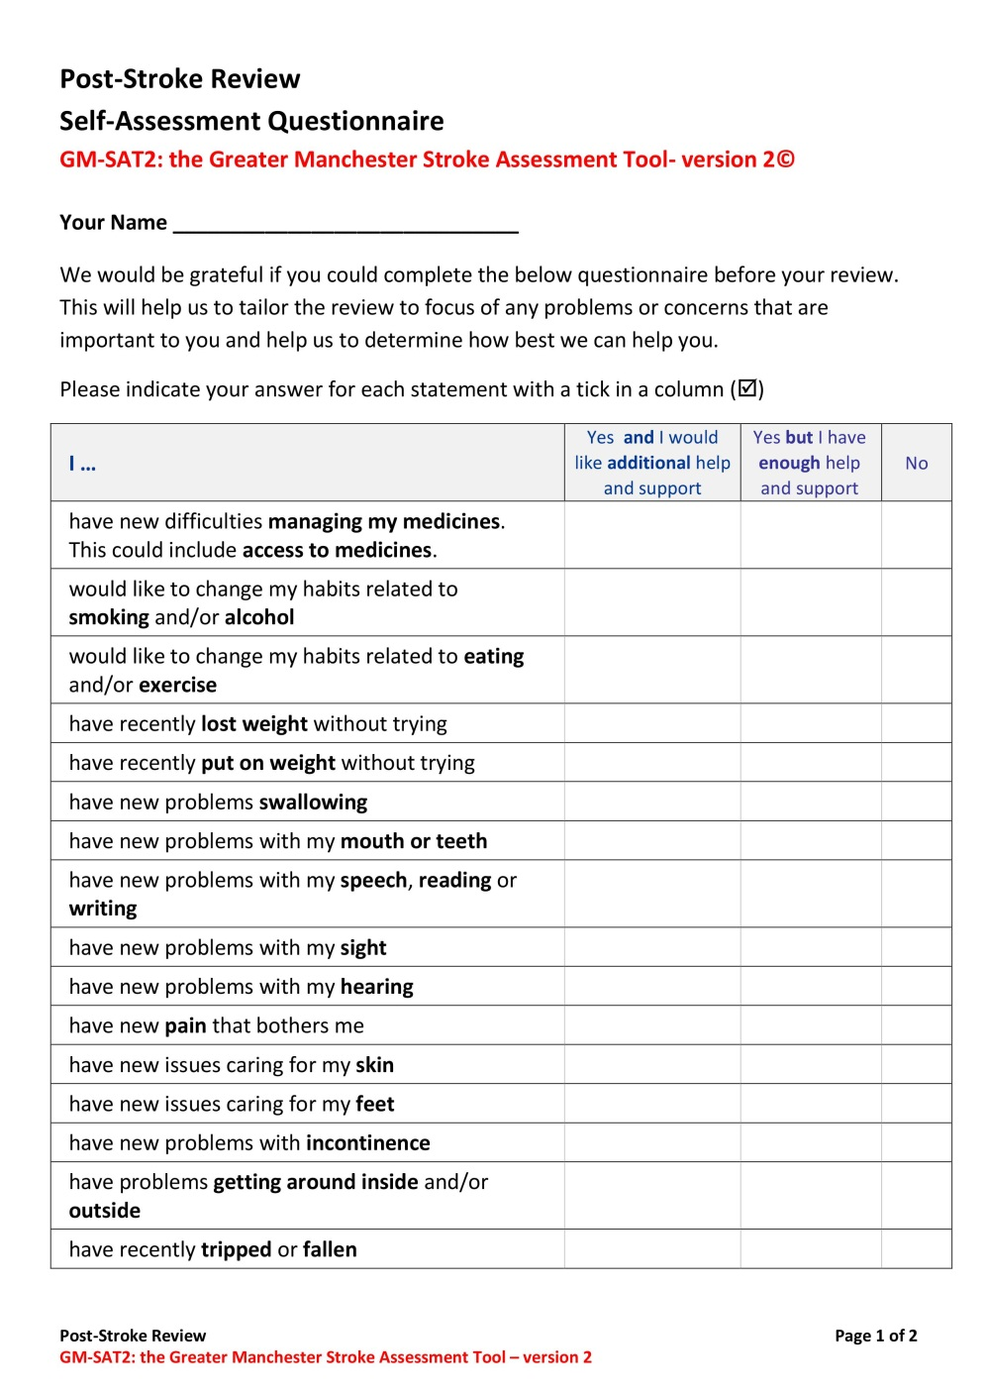
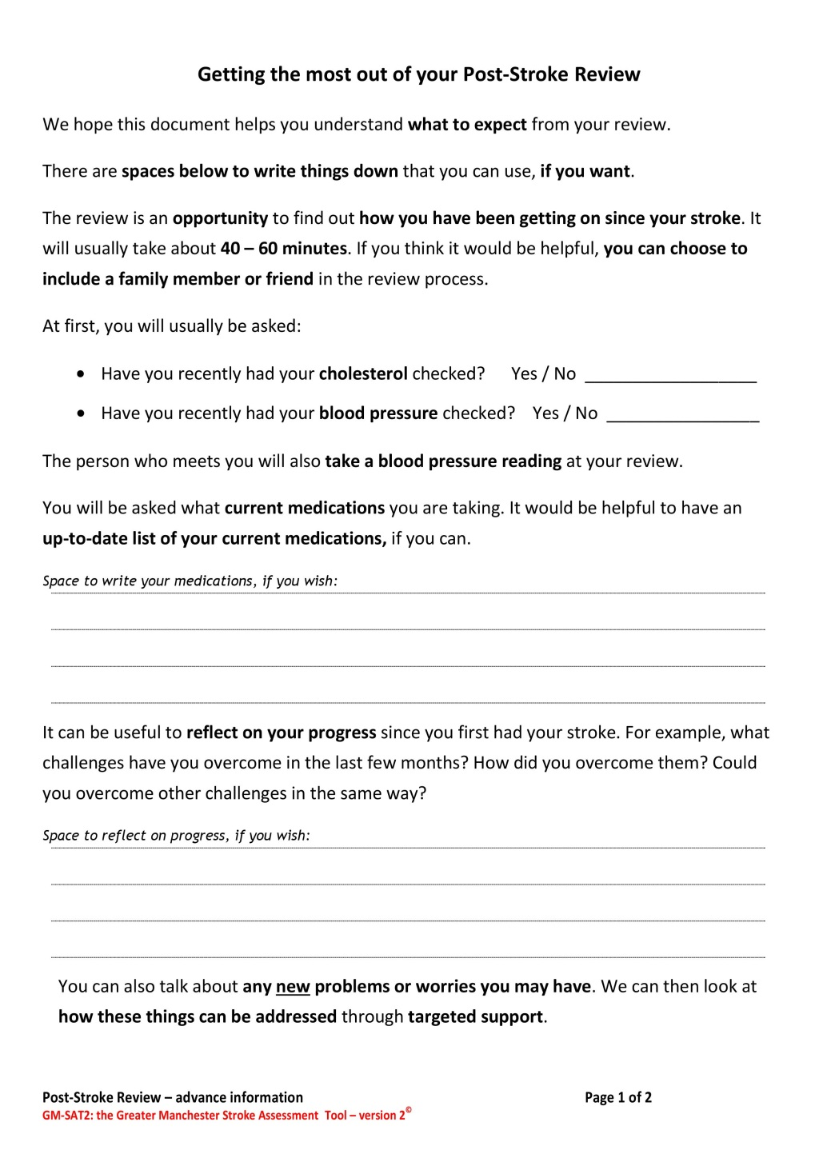
Helping prepare clients for review (from GM-SAT2)
Notes:
Encourage thinking about how they find people for review and ensure equal access
Care home residents
Out of area stroke
People discharged without rehab
- EXAMPLE: CSU might be able to support ID based on registered GP
Database / systems to integrate with hospitals to ID patients
Include people who may have additional needs
Location of review
Potential to include others in review process (with consent)* invitation letter
People with cognitive / communication needs (easy access GM-SAT)

Slide 5
Six month review process
Who can do it?
Tools to support?
Supporting cog / comms issues
Knowledge of local support?
How?
Identify service user for review
Conduct person-centred review
Step 1
Step 3
Step 2
Make appointment with service user for review
Where?
How long?
Include others?
Prepare them?

Slide 6
The purpose of post-stroke reviews
Extract from National Clinical Guideline for Stroke (2016):
5.9.1.1 Recommendations A-D
“The review should consider whether further interventions are needed, and the person should be referred for further specialist assessment if:
  ‒ new problems are present;
  ‒ the person’s physical or psychological condition, or social environment has changed.
  People with stroke should be offered further therapy if goals for specific functions and activities can be identified and agreed and the potential for change is likely.
  People with stroke should be provided with the contact details of a named healthcare professional who can provide further information and advice.
  People with stroke should be helped to develop their own self-management plan.”
Notes:
Summary
Actions could be
Information / reassurance on the day
Written information sent later
Referrals and signposting
Self-management guidance / advice
But do they agree?

Slide 7
Who can carry out reviews?
Extract from BASP Recommendations for 6 month reviews “Training & Competence” available here: https://basp.ac.uk/wp-content/uploads/2017/07/BASP-Clinical-Standards-Commitee-Recommendations-for-providing-six-month-follow-up-assessment-post-stroke-2017.docx
“It should be acknowledged that the review is regarded as an assessment process rather than a treatment session and that not ever single reviewer will have the expertise to deliver advice universally and as such having the skills to signpost and refer is of critical importance.”
Notes:
Encourage thinking about how they find people for review and ensure equal access
Anyone with skills / knowledge of
The effects of stroke and how to accommodate / rehabilitate
Services (NHS, social care & third sector) that could help address need
RCP / NICE / local guidance for up-to-date information e.g. range of BP targets, appropriate medications etc
Tools that can facilitate a review (e.g. GM-SAT)

Slide 8
Who can carry out reviews?
Extract from BASP Recommendations for 6 month reviews “Training & Competence” available here: https://basp.ac.uk/wp-content/uploads/2017/07/BASP-Clinical-Standards-Commitee-Recommendations-for-providing-six-month-follow-up-assessment-post-stroke-2017.docx
“It is important that the providers of the six month review service are embedded within a competent and skilled workforce…. Skills required include:
assessing clinical needs of patients,
trained in communication skills required for patients ….
ability to recognise emotional and psychological issues,
ability to liaise and collaborate with multidisciplinary stroke teams and signposting and referral to other services. “
Notes:
Encourage thinking about how they find people for review and ensure equal access
Anyone with skills / knowledge of
The effects of stroke and how to accommodate / rehabilitate
Services (NHS, social care & third sector) that could help address need
RCP / NICE / local guidance for up-to-date information e.g. range of BP targets, appropriate medications etc
Tools that can facilitate a review (e.g. GM-SAT)

Slide 9

GM-SAT2 includes easy access versions to support inclusivity
Notes:
Encourage thinking about how they find people for review and ensure equal access
Anyone with skills / knowledge of
The effects of stroke and how to accommodate / rehabilitate
Services (NHS, social care & third sector) that could help address need
RCP / NICE / local guidance for up-to-date information e.g. range of BP targets, appropriate medications etc
Tools that can facilitate a review (e.g. GM-SAT)

Slide 10

Knowledge of local support available
GM-SAT2 guidance for possible actions……
Notes:
Encourage thinking about how they find people for review and ensure equal access
Anyone with skills / knowledge of
The effects of stroke and how to accommodate / rehabilitate
Services (NHS, social care & third sector) that could help address need
RCP / NICE / local guidance for up-to-date information e.g. range of BP targets, appropriate medications etc
Tools that can facilitate a review (e.g. GM-SAT)

Slide 11

Six month review process
Who can do it?
Tools to support?
Supporting cog / comms issues
Knowledge of local support?
How?
Identify service user for review
Conduct person-centred review
Step 1
Step 3
Step 2
Make appointment with service user for review
Where?
How long?
Include others?
Prepare them?
Close to 6 months post-stroke event
(SSNAP = between 4 & 8 months)

Slide 12
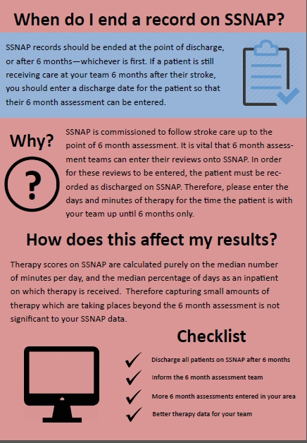
Notes:
Encourage thinking about how they find people for review and ensure equal access

Slide 13

Six month review process
Who can do it?
Tools to support?
Supporting cog / comms issues
Knowledge of local support?
How?
Identify service user for review
Conduct person-centred review
Within 2 weeks:
Complete & distribute
brief summary of review outcomes
report should be distributed to:
Service user
Service user GP
Others involved in care (with consent & as required)
Step 1
Step 3
Step 4
Step 2
Make appointment with service user for review
Where?
How long?
Include others?
Prepare them?
Close to 6 months post-stroke event
(SSNAP = between 4 & 8 months)

Slide 14
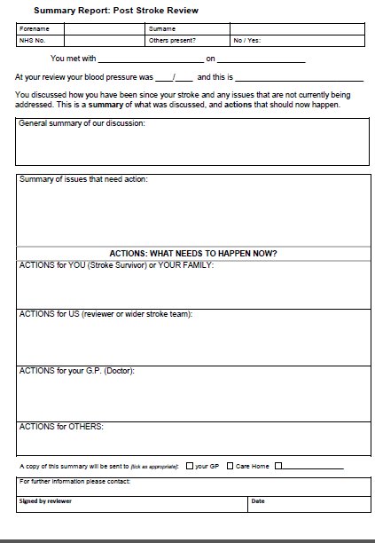
Summary report in GM-SAT2
Notes:
Encourage thinking about how they find people for review and ensure equal access

Slide 15

Six month review process
Written referrals to other agencies?
Calendar reminders?
Data sharing with other teams?
Business cases for admin support
Who can do it?
Tools to support?
Supporting cog / comms issues
Knowledge of local support?
How?
Identify service user for review
Conduct person-centred review
Complete actions identified in review
Within 2 weeks:
Complete & distribute
brief summary of review outcomes
report should be distributed to:
Service user
Service user GP
Others involved in care (with consent & as required)
Step 1
Step 3
Step 4
Step 5
Step 6
Step 2
Make appointment with service user for review
Input data on to SSNAP
Where?
How long?
Include others?
Prepare them?
& ODN database…
Close to 6 months post-stroke event
(SSNAP = between 4 & 8 months)

Slide 16
Additional Reporting / Record to ID gaps in service
Over to Tracy Walker

Slide 17
Supplementary slides

Slide 18
Following up / Implementing
Things to think about
  Who sees the full review paperwork?
  Who gets a copy of the information on actions?
  Would covering letters improve impact?
  Easy access to review reports could help delivery of future reviews (for yourself or others)
  Business case for systems that support follow ups (could be as simple as setting calendar reminder prompts)
Notes:
Encourage thinking about how they find people for review and ensure equal access

Slide 19
The purpose of post-stroke reviews
NOT a checklist of problems.
highlight progress / strengths
Identify:
Issues (new or existing & changed) not being met
Actions to address identified issues
Agents who will deliver actions
i.e. give person-centred SUPPORT
Notes:
Summary
Actions could be
Information / reassurance on the day
Written information sent later
Referrals and signposting
Self-management guidance / advice
But do they agree?

Slide 20
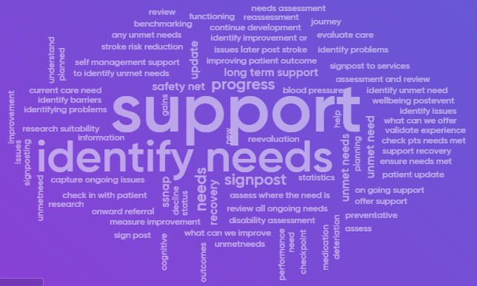
The purpose of post-stroke reviews
Word maps created from previous workshops with professionals when asked: “what do you think is the purpose of reviews?”
(N=62)
Notes:
word map from UKSF workshop – do they agree?

Slide 21
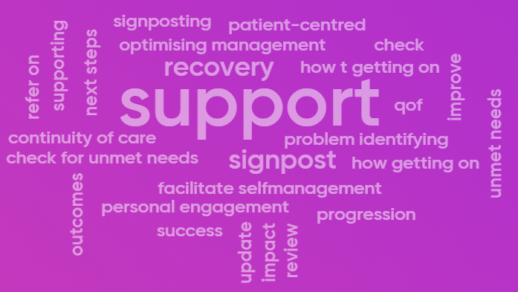
The purpose of post-stroke reviews
Word maps created from previous workshops with professionals when asked: “what do you think is the purpose of reviews?”
(N=19)
Notes:
word map from UKSF workshop – do they agree?

