Slide 1
Session 3: Calculating Target Heart Rate Zones
Andrew Battersby
Exercise Physiologist
Salford Royal Cardiovascular Rehabilitation Service

Slide 2
Considerations
Calculating Maximal Heart rate
Effect of Medications
Heart Rate Reserve

Slide 3
Calculating Maximal Heart rate
Ideally maximal heart rate would be obtained from maximal exercise test – very unlikely with majority of our patients
Various formulas available to predict maximal heart rate which have been developed using normative data.
Most commonly known method is 220-age.
Tends to underestimate HRmax in those older than 45 years old

Slide 4
Calculating Maximal Heart rate
Most commonly used method in cardiac rehab is the “Inbar” method.
206 – (age x 0.7)
E.g. if a patient is 70 years old:
  206 – (70 x 0.7)
  206 – 49 = 157 bpm
  Predicted max heart rate of 70 year old is 157 bpm

Slide 5
Effect of Medications
Beta-Blockers (commonly end in “lol” – Bisoprolol, Nebivolol, Atenolol etc)
  Reduce maximal heart rate by 20-30 bpm
  Err on the side of caution and reduce by 30 bpm
Using previous example:
if a patient is 70 years old AND taking a beta blocker:
  206 – (70 x 0.7)
  206 – 49 = 157 bpm
  157 – 30 (effect of BB) = 127 bpm
  Predicted max heart rate of 70 year old on a beta blocker is 127 bpm
Other medications to be aware of:
  Ivabradine
  Diltiazem

Slide 6
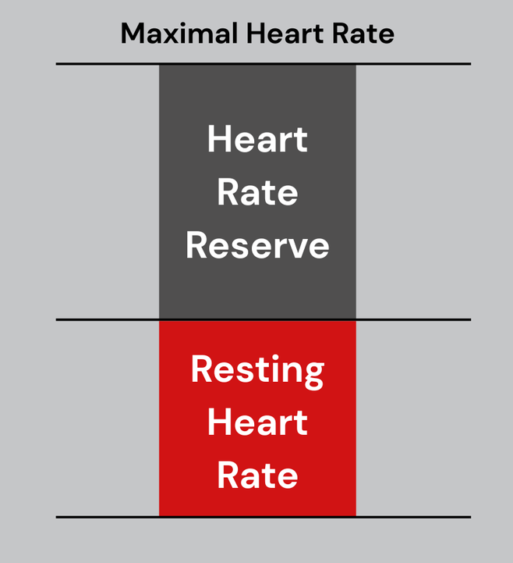
Heart Rate Reserve/ Karvonen
Preferred to %HRmax for 2 main reasons
  Directly correlates to VO2
  More individualised due to taking into account resting heart rate
Once HRmax is calculated, resting heart rate is subtracted to give us the “reserve” – how many beats between the resting and max HR.
Reserve is multiplied by target zone.
Add back onto Resting HR

Slide 7
Heart Rate Reserve
70 year old who is on a beta blocker and has a resting heart rate of 60 bpm, that you want to work at 40-70% HRR.
  206 – (70 x 0.7)
  206 – 49 = 157 bpm
  157 – 30 = 127 bpm
  127 (HRmax) – 60 (resting HR)
  Reserve = 67 bpm

Slide 8
Heart Rate Reserve
Reserve = 67 bpm
40% of 67 = 27
50% of 67 = 34
60% of 67 = 40
70% of 67 = 47
Add to resting HR (60 bpm)
60 + 27 = 87 bpm
60 + 34 = 94 bpm
60 + 40 = 100 bpm
60 + 47 = 107 bpm
Prescribed target heart rate zone 40-70% = 87 bpm to 107 bpm

Slide 9
Example 1
50 year old with a resting HR of 70, not on any rate lowering medications. Calculate 40-70% HRR.
Max HR
  206 – (50 x 0.7)
  206 – 37 = 169 bpm
Reserve:
  169- 70 = 99 bpm
40-70 % of HRR
99 x 0.4 = 40 bpm
99 x 0.7 = 70 bpm
Target Heart Rate
70 + 40 = 110 bpm
70 + 70 = 140 bpm

Slide 10
Example 2
The same patient from example 1 has now been commenced on Bisoprolol. His resting heart rate has reduced to 60 bpm
50 year old with a resting HR of 60 bpm, on Bisoprolol. Calculate 40-70% HRR.
Max HR
  206 – (50 x 0.7)
  206 – 37 = 169 bpm
  169 – 30 = 139
Reserve:
  139 - 60 = 79 bpm
40-70 % of HRR
79 x 0.4 = 32 bpm
79 x 0.7 = 55 bpm
Target Heart Rate
60 + 32 = 92 bpm
60 + 55 = 115 bpm

Slide 11
Example 3
90 year old with a resting HR of 80 bpm, taking Bisoprolol. Calculate 40-70% HRR.
Max HR
  206 – (90 x 0.7)
  206 – 63 = 143 bpm
  143 – 30 = 113 bpm
Reserve:
  113 – 80 = 33 bpm
40-70 % of HRR
33 x 0.4 = 13 bpm
33 x 0.7 = 23 bpm
Target Heart Rate
80 + 13 = 93 bpm
80 + 23 = 103 bpm

