Slide 1

Cardiorespiratory Training Day
GMNISDN
5th MARCH 2026

Slide 2
Registration from 8:45am
Session 1: Background, Exclusion Criteria & Risk Stratification
9:00-9:15 | Introduction & Background
9:15-9:30 | Medical Consensus for Exercise Post-Stroke
Session 2: Exercise Prescription
09:30-10:30 | Key Concepts: - FITT principles (Frequency, Intensity, Time, Type) - Training intensities - Risk Stratification Considerations
10:30-10:45 | Break
Session 3: Theory & Practical Skills Session
10:45-11:30 | - Calculating target zones - Blood pressure and heart rate monitoring
11:30-12:15 | Warm-ups, cool-downs, and exercise programmes for mild/moderate/severe strokes
12:15-13:00 | Lunch
Session 4: Monitoring Tools
13:00-13:30 | Outcome Measures
Session 5: Lifelong Support
13:30-14:00 | GM Active - Who they are and what they deliver
14:00-14:30 | Local Examples of Cardiorespiratory fitness application post stroke
Closing 14:30-15:00 | Summary & Next steps
Agenda

Slide 3
Session 1: Background
A quarter of all strokes are recurrent and associated with greater morbidity and economic consequence (Ali Ali, 2021).
Chances of having a second stroke can be between 25-30% within 5 years if risk factors are not managed.
Modifiable risk factors account for nearly 90% of the incidence of stroke (Ali Ali, 2021).
Transient ischemic attack is also associated with risk of future stroke, particularly in the first few months following the event: Raises risk by 4-17% within the first 90 days (SA website).
Life expectancy after stroke 5-10 years, depending on severity and several patient factors.
Notes:
15MINS
Guidelines
Why this project
What have we done so far?
After this slide – Add in the decision made from the last meeting to focus on stroke – aware many teams work across stroke and neuro – When this was reviewed in detail to start looking at delivery and risk stratification it became clear that the net was too wide across neuro populations and that some of the risk will differ, we needed buy in from consultants which would have been extremely different to include all populations

Slide 4
Stroke guideline recommendations (2023)
People with stroke should be assessed for weakness and cardiovascular fitness using a standardised approach.
Assessment and outcome measures used should encompass the range of effects of exercise including weakness, cardiovascular fitness and activities.
Clinicians should screen for, prescribe and monitor exercise programmes for people with stroke. Clinicians should liaise with other services that offer exercise-based rehabilitation (e.g. cardiac or pulmonary rehabilitation) with regard to integrating screening and exercise resources.
People with stroke, including those who use wheelchairs or have poor mobility, should be advised to participate in exercise with the aim of improving aerobic fitness and muscle strength unless there are contraindications.

Slide 5
Stroke guideline recommendations (2023)
People with stroke should be offered cardiorespiratory training or mixed training once they are medically stable, regardless of age, time since stroke and severity of impairment.
Facilities and equipment to support high-intensity (greater than 70% peak heart rate) cardiorespiratory fitness training (such as bodyweight support treadmills and/or static/recumbent cycles).
People with stroke should be supported with measures to maximise exercise adherence such as: measures to build confidence and self-efficacy (such as the use of social networking apps or physical activity platforms).
Clinicians should not use risk assessment protocols that limit training for fear of cardiovascular or other adverse events except where screening has identified intensive exercise is contraindicated for an individual.

Slide 6
Dose
Cardioresp Training
30-40min
3-5x weekly
Mixed Training
&
Circuit
X3 weekly
40-60% (HRR)
10-20 weeks
20 weeks
50-70% (strength – one rep max)

Slide 7
Stroke guideline recommendations (2023)
Physical activity programmes for people with stroke or TIA may be delivered by therapists, fitness instructors or other appropriately trained people, supported by interagency working where possible.
Stroke rehabilitation services should build links with community-based exercise facilities (such as support groups, gyms, leisure centres or exercise referral schemes) to support people with stroke to transition to ongoing physical activity on completion of an exercise programme.
Stroke services should consider working with other established rehabilitation services, such cardiac or pulmonary rehabilitation, to develop exercise-based programmes and ensure access to equipment and screening protocols.
Notes:
Treatment

Slide 8
Advice & Education
Ensuring patients and family/carers know the benefits of exercise and why they are doing it, including how the exercises given relate to their individual needs
Incorporation of exercise into documented goal setting
Individualisation of exercise programme to suit their abilities and goals
Use of technology (e.g. apps, videos, phone check-ins)
Ongoing coaching to support written exercise instructions
Involvement of family and carers with exercise

Slide 9
Scoping Summary
Linked with researchers and PHD students nationally to understand most up to date research
Linked with the cardiac network, attended a cardiac rehab class at SRFT
ACPICR guidelines
BACRP Standards
Found no current national pathway for stroke patients to access ‘cardiac rehabilitation’ classes
Linked with organisation’s outside the NHS: GM Active & clinical exercise physiologists academics
Notes:
This is the slide from last time = Oct 2024 which does lead us to why we are where we are….

Slide 10
What are we currently delivering across GM?
NHS
Third Sector
Early rehabilitation of stroke and neuro patients including goal setting and onward referrals
Consideration of mental health and impact on motivation and wellbeing
Provision of 1:1 and group-based exercises either specific to certain conditions or generalised to falls, core stability, upper limb and lower limb
Functional rehabilitation as part of neurological rehabilitation programme may be exerting patients to their maximum cardiorespiratory level
Some consideration of cardiorespiratory fitness but this is varied
Some joint working and onward referrals to third sector organisations though this is varied
Joint working across stroke/neuro and cardiac services
Exercise on referral schemes are available across GM
Each locality has public sector gym/pool available for public use
Various exercise groups are available to the general public with some more focussed classes
There is also a health education provision within these settings though this is varied across the region
All public facilities have professionals trained in exercise and cardiorespiratory fitness
Charity sector have some provision of exercise groups and equipment.
Notes:
(though this is varied and knowledge of impact of health conditions can be limited)

Slide 11
Where are the gaps in local and regional service provision?
Challenges with environment such as limited space and limited equipment
Challenges with staffing either through reduced numbers or reduced capacity to manage cardiorespiratory needs
No clear guidance for practical delivery or incorporation into existing rehabilitation models
Varied levels of confidence and competence across all teams in all areas
Knowledge of local services available across the public, private and charitable sector is varied and somewhat limited
Handover of patients between services is usually focused on neuro-rehab need and doesn’t necessarily take into consideration the patients cardiorespiratory fitness level/progress/need
Varied provision of patient and carer education on cardiorespiratory fitness
Limited service provision for younger people or those still working
Limited links between NHS clinicians and social prescribing professionals in some areas
Services are applying principles of aerobic exercise, but at varied intensities and consistencies, likely not at a level to have an impact of cardiorespiratory health
Limited use of cardiorespiratory outcome measures
Limited knowledge of target heart rate zones and applying to the stroke/neuro patient
Varied provision of group exercise across GM – postcode lottery
Classes may be full and difficult to access
Difficulty with access to modified or accessible equipment
Transport to venues can be problematic for patients
Funding of gym membership / class attendance can be prohibitive
Class provision is sometimes limited to 12 week blocks with limited follow-on provision
Knowledge of specific health conditions may be limited in some areas

Slide 12
What do we want to take forward?
Improving communication between NHS and third sector partners
Identification and screening of patients appropriate for cardiorespiratory training
Education for clinicians (cardiorespiratory training, parameters risks etc)
Education for exercise professionals
Education on locality and regional services and resources across GM
Improved handover of cardiorespiratory aspects of rehab between inpatient, community and third sector partners
Establishment of appropriate pathways including signposting and exit strategies for all services, incorporating self-management
Focus on prevention and secondary prevention
Patient education around importance of cardiorespiratory fitness
Use of technology and innovation within rehabilitation

Slide 13
Medical Consensus for Exercise Post-Stroke
What can we surmise….
That we are not in a position to write national guides for Cardiorespiratory Rehab for stroke patients, that risk screening can be suggested but not enforced.
That the advice from CR clinicians is to focus on absolute contraindications clarification. Then see the high-risk patients first who can be started off low level whilst teams adjust to OMs and delivery of the level of care.
For the few patients who may be ‘high risk’ but still mobile, active and wanting to push them selves -Consultant advice will need to be sought on a case-by-case basis.
That whilst baseline measures and measuring heart rate and BP is an additional task for staff it is also good and best practice to ensure that the CR rehab provided is of actual benefit.
That the service set up suggested in the KITE/START tool is not deliverable in the UK. This is a stand-alone service spec which is something to aspire too but highly unlikely to be funded. CR services do not have this service set up.
Notes:
That sub maximal testing could be explored but not focusing on MET (maximum exertion testing) as it is specialist
The international guidance tools for stroke specific cardiorespiratory exercise are for services set up specificaly to deliver this as the UK CR NHS teams are set up. And not devised for stroke rehab teams as they are in the current climate.
But we can not ignore the guidance either and in an ideal world will add to the reasoning may be for CR teams to be taking both stroke and Cardiology patients

Slide 14
How was the consensus gathered ?
- We have met with multiple academics, authors, clinicians to horizon scan the world of stroke and cardiorespiratory rehab - there are flutters of activity but nothing robust. All agreed the stark paucity of guidance re contraindications.
- Reviewed the evidence base again for strength – limited within stroke
- Reviewed our guidelines and that of the British ACPIRC standards with a focus on risks.
Discovered the Canadian - KITE research institute - START toolkit – Stroke Aerobic Exercise Toolkit.
Refreshed our appreciation of the already specialised world of CR and strengthened links with Andy and his team for support.
Presented all the above with a draft version of recommendations to the Stroke consultant group who agreed to participate.
2nd Draft written and sent to all Stroke consultants across GM to comment with concerns – minimal response (assume happy)
3rd Draft sense checked with HASU consultants from 3 stroke centres.
Final version presented to CEG – approved as a local guide in the absence of more robust national guidance.

Slide 15
Contraindications
Stroke-Specific Medical Consensus (GMNISDN 2025)
General considerations:
There should be a delay of 2 weeks after ischaemic stroke and 4 weeks after a intracerebral haemorrhage before commencing CR to the levels suggested in the guidance
Patients with revascularisation procedures of any type e.g. thrombolysis, thrombectomy or carotid endarterectomy, should commence CR only if 2 weeks have elapsed after their procedure and they are medically stable with stable blood pressure, heart rate and capillary blood glucose
Those who have undergone other surgical or neurosurgical interventions at the time of the stroke, including hemicraniectomy, should seek consultant advice before commencing CR
All other major risks are cardiac and should be viewed as the same as they are within cardiorespiratory guidance set out in The Standards for Physical Activity and Exercise in the Cardiovascular Population
The only other absolute stroke specific contraindication is free-floating thrombus in any major extracranial/intracranial artery. Patients should not start CR until repeat imaging has shown complete resolution of the thrombus, however long that may be, and consultant advice should be sought

Slide 16
Contraindications
  Absolute contraindications for CR post stroke
  Acute myocardial infarction and stroke - not to participate in CR for 4 weeks and to seek medical advice thereafter
  Ongoing unstable angina
  Uncontrolled cardiac arrhythmia with haemodynamic compromise
  Active endocarditis
  Arterial dissection
  Symptomatic severe aortic stenosis
  Decompensated heart failure or acute heart failure in the last 4 weeks
  Acute myocarditis or pericarditis in the past 4 weeks
  Acute aortic dissection
  Physical disability, cognitive impairment or communication deficit that precludes safe and adequate testing/participation
  Pulmonary embolism or deep vein thrombosis - not to participate in CR for 4 weeks
  Free floating thrombus
  Other acute systemic infection
  Uncontrolled seizure disorder
Notes:
ACPICR + BACPR + KITE (combined)

Slide 17
Contraindications
  Relative contraindications:
Known obstructive left main coronary artery stenosis
Any cardiac surgery including implanted devices cardiology advice must be sought
Moderate-to-severe aortic stenosis with uncertain relationship to symptoms
Acquired, advanced or complete heart block
Cognitive or communication impairment with limited ability to co-operate
Not to undertake cardiorespiratory rehabilitation if resting BP >180 systolic.
Post Intracerebral haemorrhage and Post Carotid Endarterectomy patients should have a resting BP of <160 systolic before participating in CR.
Uncorrected medical conditions e.g. significant anaemia, electrolyte imbalance or hyperthyroidism – seek medical advice

Slide 18
Essential equipment and data access
Access to latest ECG + Echo with interpretation. This will require increased communication between therapy and medical staff in both the inpatient and community setting. Is this feasible? Do we feel as group that this is necessary?
Access to BP monitor, HR monitor, SATS device essential does seem sensible and essential.
Access to latest CBG result if IDDM. This should be available in both hospital and home settings.
(heart rate monitors are not accurate in AF so staff will either need to be confident with manual testing of this).
Notes:
CR services have ECG and echo interpreted and largely understood within the team or have direct access to the CRI dept and consultants should dthis be needed. Our teams wont and will not know how to interpret ECGs.

Slide 19
Session 2: Key Concepts
Cardiovascular Exercise Prescription in Clinical Populations
Andrew Battersby
Exercise Physiologist
Salford Royal Cardiovascular Rehabilitation Service

Slide 20
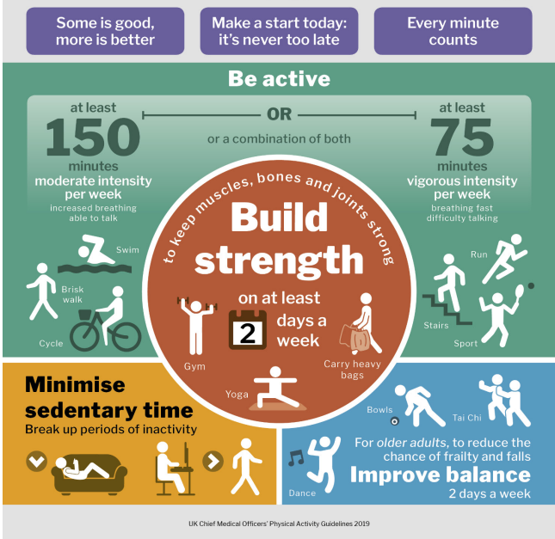

Slide 21
Stroke Guidelines 2023
People with stroke or TIA should:
  participate unless there are contraindications.
  Exercise should be individualised, and reflect treatment goals and activity recommendations.
  regardless of age, time since having the stroke, and severity of impairment.
  medium intensity CV - 40%-60% of HRR reserve
  strength training 50-70% of 1RM
  30-40 minutes x 3 to 5 times a week
  aim to be active every day and minimise the amount of time spent sitting for long periods.
  engage in additional physical activity which incorporates balance and co-ordination, at least twice per week.

Slide 22
Stroke Guidelines 2023
People with stroke or TIA should:
  participate unless there are contraindications.
  Exercise should be individualised, and reflect treatment goals and activity recommendations.
  regardless of age, time since having the stroke, and severity of impairment.
  medium intensity CV - 40%-60% of HRR reserve
  strength training 50-70% of 1RM
  30-40 minutes x 3 to 5 times a week
  aim to be active every day and minimise the amount of time spent sitting for long periods.
  engage in additional physical activity which incorporates balance and co-ordination, at least twice per week.

Slide 23
Cardiovascular exercise is defined as:
physical activity that engages large muscle groups in a rhythmical manner, aiming to improve cardiovascular fitness by utilizing aerobic energy pathways, typically after approximately 5 minutes of sustained effort.
Can be referred to as cardiovascular, cardiorespiratory, aerobic or cardio

Slide 24
What Intensity to Prescribe?
High Intensity
Mod-High
Intensity
Risk of Event/injury
Low-Mod
Intensity
Fitness Benefit
Level of
Benefit
Improved endothelial integrity
Decreased sympathetic stimulation
Improved lipids
Reduced fibrinogen
Increased haematocrit/ plasma volume
Reduced myocardial irritability
Low Intensity
Health Benefit
Increased calorie expenditure
Blood Glucose improvement
Reduced BP
Enhanced Mood + Mental Well-being
“The sweet spot”
50-70% VO2max
60-85% HRmax
Intensity of Activity
Notes:
So where does intensity and fitness fit in?
This slide nicely summarises that low intensities are associated with no gains in fitness but significant health benefits.
Building slides.......

Slide 25
Intensity
Would you class walking at 3 kph @ 2 % gradient as low, moderate or high intensity?
Approx 3 METs (VO² of 10.5 ml/kg/min)
Intensity is relative to fitness level of the individual!
If a patient had a functional capacity of 4 METs – High Intensity (>70% of max)
If a patient had a functional capacity of 10 METs – Low Intensity (<40% of max)
If a patient had a functional capacity of 6 METs – Moderate Intensity (40% - 70% of max)

Slide 26
How do you measure functional capacity?
Maximal/submaximal CPET
Maximal ETT
Sub maximal test
Not assessed
Estimated using questionnaires
Most accurate to least

Slide 27
Submaximal Exercise Tests
Intermittent shuttle walk test (bleep test)
Incremental treadmill protocols (Bruce/Gardner-Skinner)
Cycle Ergometer test
Chester test step
6 minute walk test
Timed up and go test
Sit to stand test

Slide 28
Questionnaires
Validated:
  Duke Activity Status Index (DASI)
  Veterans Specific Activity Questionnaire (VSAQ)
Non-validated
  Questioning current activity and comparing to “compendium of physical activity”
    Eg patient tells you they walked 1 mile in 20 minutes last night (on flat ground).
    = approx. 3 miles per hour walking speed.
    = approx. 3.5 METs
https://pacompendium.com/

Slide 29
How to Prescribe/Monitor Intensity
METs
Heart Rate
RPE

Slide 30
METs
Metabolic equivalent of task
1 MET = 3.5 ml/kg/min = resting level
Once max MET is predicted, specific guidance on speed, resistance, incline etc can be prescribed on a range of exercises to equate to desired intensity.
Can be time-consuming
Needs to be recalculated as patient’s fitness increases (or decreases)

Slide 31
Heart Rate
Heart rate is used as a surrogate marker of VO₂ when monitoring CV exercise intensity.
Unlikely to have information on true maximal heart rate but can be predicted reasonably accurately using standardised formula.
Once maximal heart rate is known/predicted, exercise can be prescribed to elicit a certain percentage of their maximal heart rate.
Most commonly used method in clinical populations is called heart rate reserve (HRR) (also known as the Karvonen method). Preferred as it takes into account resting heart rate, therefore greater individualisation, but also because the % of HRR directly correlate to % of VO2 Max.

Slide 32
Heart Rate
Limitations:
  Calculations all have margins of error
  Effects of medications
  Can be hard to easily monitor for patients with AF
  Some conditions can cause “chronotropic incompetence” e.g. heart failure and Parkinson's
  Can be hard to monitor during certain activities
  Patients can become “dependant” on seeing their HR response during exercise (barrier to independent exercise)

Slide 33
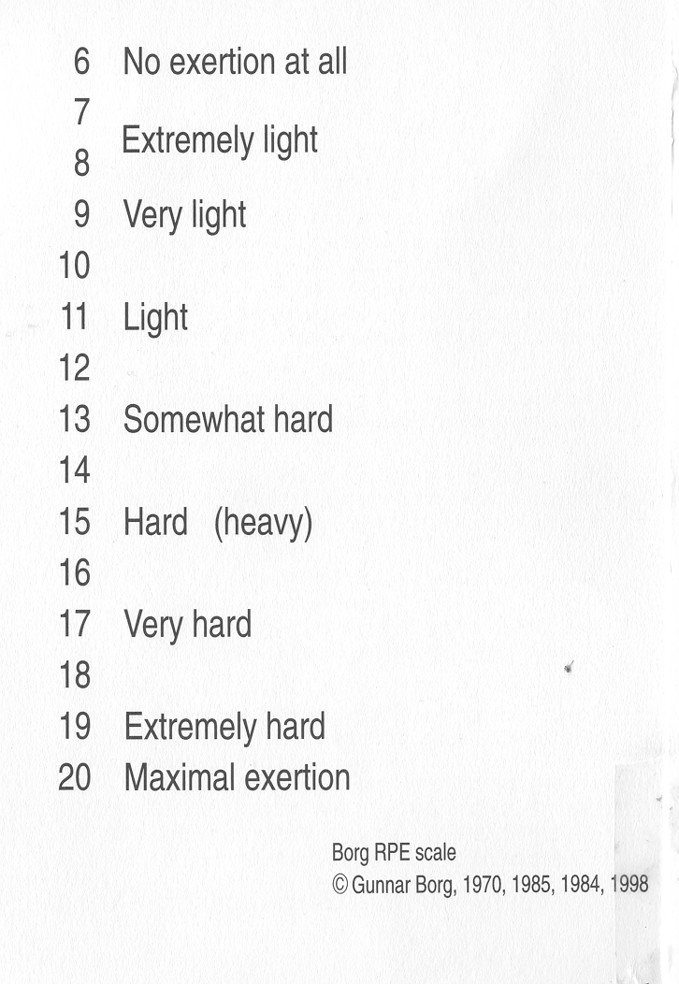
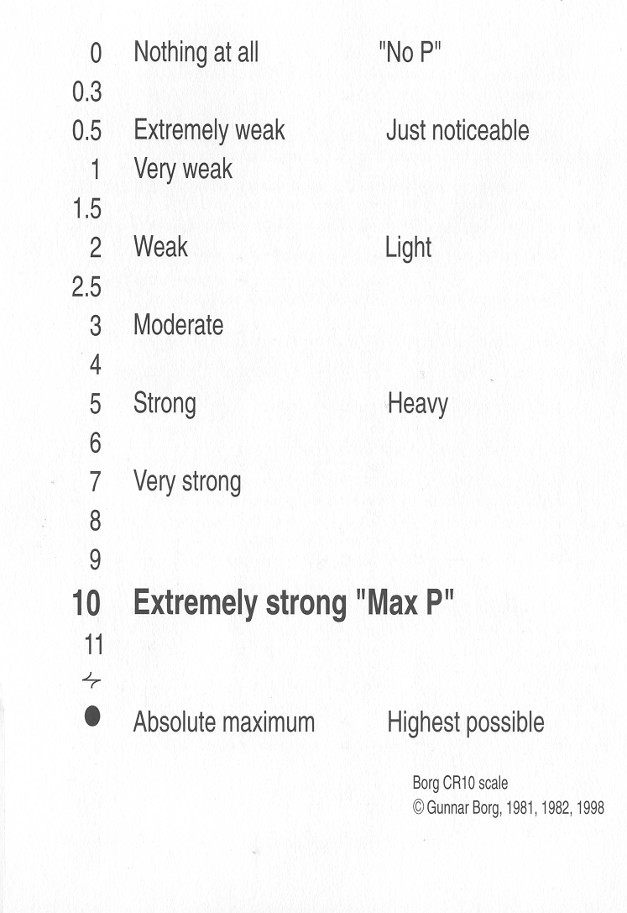
Rating of Perceived Exertion (RPE) / Borg Scales
Notes:
The only validated scale – NO COLOUR

Slide 34
RPE (6-20) Scale
Strong correlation between overall effort level (mainly guided by muscular fatigue and level of breathlessness) and cardiovascular demand (HR/Vo2).
In young men each increase on RPE elicits approx. 10 bpm increase in HR.

Slide 35
Borg 10-point Category Ratio (CR10) Scale
Modified version of dyspnoea scale
More useful when there is one overriding “sensation”.
  Examples:
  Resistance training – localised muscle fatigue
  Arthritis – Localised joint pain
  COPD – high level of breathlessness but not in keeping with overall cardiovascular demand.

Slide 36
How to Increase Reliability and Validity of RPE
Anchor top and bottom of scales
Familiarise with incremental activity
Emphasise use of verbal descriptors
Keep in view at all times
Do not modify the scale (no colours or smiling/sad faces)
Try not to guide a patient to an answer
Give opportunities to practice use (on the ward, take-home scales)

Slide 37
Intensity | V02max (%) | HRmax (%) | HRR (%) | RPE 6-20 Scale | RPE 1-10 Scale | Energy System
Low/Light | < 40 | < 55 | < 40 | 10 – 11 | 2-3 | Aerobic
Moderate | 40 – 69 | 55 – 74 | 40 – 69 | 12 – 13 | 4-5 | Aerobic
High | 70 – 85 | 75 – 90 | 70 – 85 | 14 – 16 | 6-7 | Aerobic + lactate
Very High | 85 | > 90 | > 85 | 17 - 19 | 8-9 | Aerobic + Lactate + Anaerobic

Slide 38
When to Prescribe Low Intensity Exercise
May be appropriate initially for:
  High risk patients
  New to activity
  Low function/high levels of fatigue to enable greater exercise time (volume = intensity x duration)
  Anxious patients
Notes:
High risk can still progress to higher intensities as appropriate

Slide 39
Risk Stratification
Stratifying the risk of adverse cardiovascular event during exercise (not the risk of further cardiovascular event!)
Provides rehab team with information for patient management
  Exercise intensity
  Level of monitoring
  Supervision level

Slide 40
AACVPR Risk Stratification Tool (2021)
LOWEST RISK C if ALL of the following factors are present: | MODERATE RISK B if meet neither High Risk nor Low Risk standards: | HIGH RISK A ANY ONE OR MORE of the following:
Left ventricular ejection fraction > 50% No resting or exercise-induced complex dysrhythmias Uncomplicated MI, CABG, angioplasty, atherectomy, or stent: Absence of CHF or signs/symptoms indicating post-event ischemia Normal hemodynamic and ECG responses with exercise and in recovery Asymptomatic with exercise or in recovery, including absence of angina Maximal functional capacity at least 7.0 METs* Absence of clinical depression or depressive symptoms | Left ventricular ejection fraction = 35–49% Signs/symptoms including angina at “moderate” levels of exercise (60–75% of maximal functional capacity) or in recovery Mild to moderate silent ischemia (ST depression less than 2mm) with exercise or in recovery Functional capacity < 5 METS | Left ventricular ejection fraction < 35% Survivor of cardiac arrest or sudden death Complex ventricular dysrhythmias (ventricular tachycardia, frequent [> 6/min] multiform PVCs) at rest or with exercise MI or cardiac surgery complicated by cardiogenic shock, CHF, and/or signs/symptoms of post-procedure ischemia Abnormal hemodynamics with exercise, especially flat or decreasing systolic blood pressure or chronotropic incompetence with increasing workload Significant silent ischemia (ST depression 2mm or greater without symptoms) with exercise or in recovery Signs/symptoms including angina pectoris, dizziness, lightheadedness or dyspnea at low levels of exercise (< 5.0 METs) or in recovery Presence of heart failure Presence of clinical depression Functional capacity less than or equal to 3 METS Implantable Cardioverter defibrillator

Slide 41
Main considerations
  Heart function
  Arrythmias
  On-going ischaemia
  On-going symptoms
  Functional capacity
  Haemodynamic responses (HR/BP)
  Devices (ICD/PPM/CRT)
  Clinical Depression

Slide 42
Issues with Risk Stratification Protocols
Co-morbidities not included
Most UK patients won’t have maximal exercise testing prior to commencing rehab
Diastolic HF (pEF) / Issues with RV
Ability to self monitor not included (cognitive impairment)
All ICDs equal?
Notes:
Stress echocardiography today has matured into a robust and reliable technique not only for the diagnosis of suspected coronary artery disease (CAD) but also for the accurate risk stratification of patients with suspected and established CAD. This is mainly because of rapid advances in image acquisition, digital display, and the development of harmonic and contrast imaging. With advances in myocardial perfusion imaging, stress echocardiography now allows simultaneous assessment of myocardial function and perfusion. Tissue Doppler imaging allows quantitation of wall motion.
Stress protocol and interpretation
Stress echocardiography may be performed in conjunction with dynamic exercise (treadmill or bicycle). In patients who are unable to exercise, pharmacological agents may be used, such as dobutamine or dipyridamole. With any form of stress testing echocardiographic images are first acquired digitally during rest in parasternal and apical views. These views of the heart visualise all three vascular territories.
Stress echocardiography can quantify the severity and extent of myocardium in jeopardy and thereby predict risk.^{17,18,23,24} The total amount of myocardium in jeopardy can be assessed at peak stress by adding the peak stress score and dividing by the number of segments (summed stress score) assessed in a polar map using the American Society of Echocardiography 16 segment LV model

Slide 43
Why does exercise increase the risk of a cardiac event?

Slide 44
Immediate Post Exercise Acute Exercise Stress
Abrupt cessation of activity
Arterial vasodilatation
Sympathetic Activity
Na+ / K + Imbalance
Catecholamines
+
Venous return
⇩ Vagal Stimulation
Warm up
Moderate intensity
Cool down
Keep feet moving
Cardiac Output
HR, SBP
Blood Pressure
MVO₂
(CHD)
Coronary perfusion
Ischaemia
⇧ Myocardial Irritability
Altered Depolarisation / Repolarisation
Altered Conduction velocity
Ventricular Ectopic Activity
Franklin & Gordon, 2005
Notes:
44
Exercise increases myocardial workload
Increase likelihood of ischaemia
Increase likelihood of arrhythmia
-Introduction to risk associated with exercise
Q - What information can we use to tell us if ischaemia ,irritability and increased ventricular ectopic activity are present
Remember: also risks post ex
Following CR standards and guidelines reduces risks ie – prolonged warm up / cool down, keeping feet moving, monitoring, observation post session
Increase in HR and SBP on exercise is oxygen consuming, catecholamines are arrhythmogenic

Slide 45
Context for greater risk during exercise
Least physically active people (sedentary)
Those with lower levels of fitness (<5 METs max)
Highly emotive activities (overly competitive)
Intense start to exercise
Unaccustomed to the mode of physical activity (novices)
High relative exercise intensity (BP, HR or RPP)
Sudden cessation of exercise

Slide 46
Summary
Physical activity is beneficial to health and all patients (unless contra-indicated at present) should be supported to increase their physical activity levels, with the aim of achieving the government guidelines.
Exercise should be prescribed based on the patients;
  Current fitness level
  Risk stratification
  Co-morbidities
  Preference and individual goals
Moderate intensity exercise is safe for most patients, if structured and monitored appropriately.
Low intensity exercise may be more appropriate initially for some patients and will still have significant health benefits if done with sufficient frequency/duration.

Slide 47

Break

Slide 48
Session 3: Calculating Target Heart Rate Zones
Andrew Battersby
Exercise Physiologist
Salford Royal Cardiovascular Rehabilitation Service

Slide 49
Considerations
Calculating Maximal Heart rate
Effect of Medications
Heart Rate Reserve

Slide 50
Calculating Maximal Heart rate
Ideally maximal heart rate would be obtained from maximal exercise test – very unlikely with majority of our patients
Various formulas available to predict maximal heart rate which have been developed using normative data.
Most commonly known method is 220-age.
Tends to underestimate HRmax in those older than 45 years old

Slide 51
Calculating Maximal Heart rate
Most commonly used method in cardiac rehab is the “Inbar” method.
206 – (age x 0.7)
E.g. if a patient is 70 years old:
  206 – (70 x 0.7)
  206 – 49 = 157 bpm
  Predicted max heart rate of 70 year old is 157 bpm

Slide 52
Effect of Medications
Beta-Blockers (commonly end in “lol” – Bisoprolol, Nebivolol, Atenolol etc)
  Reduce maximal heart rate by 20-30 bpm
  Err on the side of caution and reduce by 30 bpm
Using previous example:
if a patient is 70 years old AND taking a beta blocker:
  206 – (70 x 0.7)
  206 – 49 = 157 bpm
  157 – 30 (effect of BB) = 127 bpm
  Predicted max heart rate of 70 year old on a beta blocker is 127 bpm
Other medications to be aware of:
  Ivabradine
  Diltiazem

Slide 53
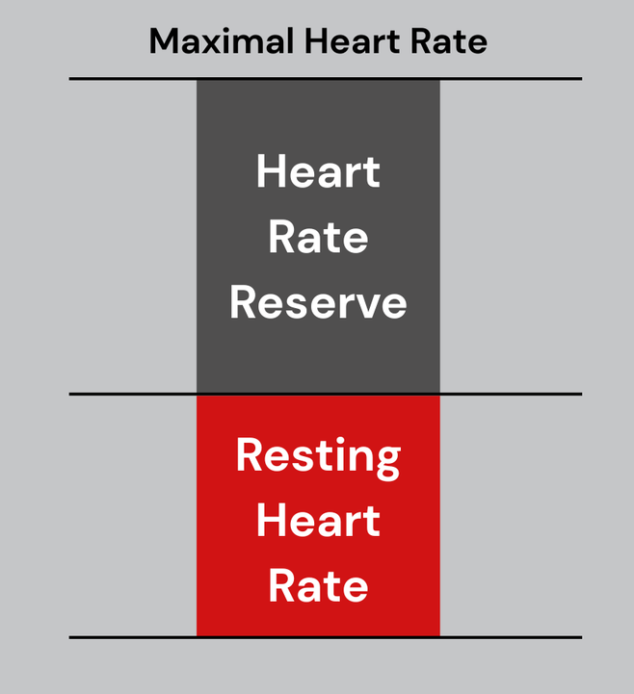
Heart Rate Reserve/ Karvonen
Preferred to %HRmax for 2 main reasons
  Directly correlates to VO2
  More individualised due to taking into account resting heart rate
Once HRmax is calculated, resting heart rate is subtracted to give us the “reserve” – how many beats between the resting and max HR.
Reserve is multiplied by target zone.
Add back onto Resting HR

Slide 54
Heart Rate Reserve
70 year old who is on a beta blocker and has a resting heart rate of 60 bpm, that you want to work at 40-70% HRR.
  206 – (70 x 0.7)
  206 – 49 = 157 bpm
  157 – 30 = 127 bpm
  127 (HRmax) – 60 (resting HR)
  Reserve = 67 bpm

Slide 55
Heart Rate Reserve
Reserve = 67 bpm
40% of 67 = 27
50% of 67 = 34
60% of 67 = 40
70% of 67 = 47
Add to resting HR (60 bpm)
60 + 27 = 87 bpm
60 + 34 = 94 bpm
60 + 40 = 100 bpm
60 + 47 = 107 bpm
Prescribed target heart rate zone 40-70% = 87 bpm to 107 bpm

Slide 56
Example 1
50 year old with a resting HR of 70, not on any rate lowering medications. Calculate 40-70% HRR.
Max HR
  206 – (50 x 0.7)
  206 – 37 = 169 bpm
Reserve:
  169- 70 = 99 bpm
40-70 % of HRR
99 x 0.4 = 40 bpm
99 x 0.7 = 70 bpm
Target Heart Rate
70 + 40 = 110 bpm
70 + 70 = 140 bpm

Slide 57
Example 2
The same patient from example 1 has now been commenced on Bisoprolol. His resting heart rate has reduced to 60 bpm
50 year old with a resting HR of 60 bpm, on Bisoprolol. Calculate 40-70% HRR.
Max HR
  206 – (50 x 0.7)
  206 – 37 = 169 bpm
  169 – 30 = 139
Reserve:
  139 - 60 = 79 bpm
40-70 % of HRR
79 x 0.4 = 32 bpm
79 x 0.7 = 55 bpm
Target Heart Rate
60 + 32 = 92 bpm
60 + 55 = 115 bpm

Slide 58
Example 3
90 year old with a resting HR of 80 bpm, taking Bisoprolol. Calculate 40-70% HRR.
Max HR
  206 – (90 x 0.7)
  206 – 63 = 143 bpm
  143 – 30 = 113 bpm
Reserve:
  113 – 80 = 33 bpm
40-70 % of HRR
33 x 0.4 = 13 bpm
33 x 0.7 = 23 bpm
Target Heart Rate
80 + 13 = 93 bpm
80 + 23 = 103 bpm

Slide 59
Practical Session
Calculating Target Heart Rate Zones, Blood Pressure and Manual HR

Slide 60
Session 3: Exercise Programmes
Case Study 1
48yr old male, 3 weeks post ICH (cerebellum). Aetiology remains unclear a/w follow up MRB but was hypertensive on admission (not now). Resting HR 60. No previous PMH. Discharged home 1 week post ICH. Mobile, self-caring. Ongoing deficits high level balance and fatigue. Wants to get back to the gym, and exercise whilst off work.

Slide 61
Case Study 2
76yr old female. R Fronto parietal embolic stroke. New atrial fibrillation commenced on anti-coagulation 2 weeks post stroke. Pmh - Asthma, htn, hyperlipaemia, diverticulitis.
Now mostly hypotensive and Amlodipine on hold but is on Bisoprolol for rate control. HR 78. Remains an inpatient on stroke rehab for LSW with focus on transfers and basic ADLs fatigues quickly with delayed processing but otherwise cognitively intact. Preadmission walked her dog 3x daily approx. 2-3miles each time.

Slide 62
Case Study 2: Answers
Risk Screening | 2 weeks post stroke Newly diagnosed AF on anticoagulation Taking betablocker medication Active lifestyle pre-admission Hypotension – have they ate/drink prior to session. Fluid available during session. Possibly check BP pre and post warm up to assess for any drops. Asthma – do they have inhalers? When did they last take them? Impact on HR?

Slide 63
Case Study 2: Answers
Heart Rate Reserve | Prediction of HRmax: 206 – (0.7 x 78) = 151 Adjustment for BB – 30 Predicted HRmax = 121 bpm Heart rate reserve: HRmax – resting heart rate 121 – 78 = 43 bpm % of HR reserve: 40% of 43 = 17 50% of 43 = 22 60% of 43 = 26 70% of 43 = 31 Target HR: Add % of HR reserve to resting HR: 40% = 78 + 17 = 95 50% = 78 + 22 = 100 60% = 78 + 26 = 104 70% = 78 + 31 = 109 40% = 95 bpm 50% = 100 bpm 60% = 104 bpm 70% = 109 bpm | Considerations: May struggle to accurately measure HR with HR monitors/watches due to presence of AF. May require manual pulse checks HR can take up to 3 minutes to stabilise at given workload. Don’t increase exercise intensity if not reaching target heart rate initially. RPE RPE scale – aiming for 11-12 initially. Asthma may cause increased breathlessness which could skew RPE rating. May want to use 1-10 scale and ask for 2 different RPE ratings – Rating for muscular fatigue and rating for breathlessness. Set a slightly higher target for breathlessness than muscular fatigue. May want to check Spo2 levels on initial exercise session to assess for any drops during exercise

Slide 64
Case Study 2: Answers
Programme | Fatigues quickly – reduce session duration and aim to increase frequency. Interval approach (work:active recovery) Likely initially aim for lower end of target heart rate zone initially for 1-2 minute intervals interspersed with active recovery. Active recovery should have lower body movement to aid venous return and reduce risk of hypotension. Warm up and cool down time should be appropriate to work out time (i.e. 15 minute warm up is not realistic if total workout time is only going to be 20 minutes). Delayed processing time – think of exercise complexity – simple exercises such as step ups, marching, shuttle walks, cycling. Caution with quick changes in posture such as sit to stand due to on-going hypotension. No floor- based exercises | Warm Up: Duration: 5 minutes Seated with a focus on mobility and gentle pulse raiser. 30 seconds of bouncing heals interspersed with 30 seconds of: Shoulder rolls Bicep curls Seated marching Heel digs Side taps CV Conditioning component Duration 10 minutes 1 minute seated gentle marching (standing or seated) interspersed with 1 minute of: Shuttle walks Step ups Half stars High knee marching Standing hamstring curls Cool Down Duration 5 minutes Seated gentle heel bouncing interspersed with static stretching for 10-20 for major muscle groups.

Slide 65
Case Study 2: Answers
Outcome Measures | 6 minute walk test performance Handgrip strength Timed up and go RPE on given workloads ?HR on given workloads Outcome questionnaires (HADs + Dartmouth + SARC-F)

Slide 66
Case Study 3
64yr old male. 5 weeks post R frontal ICH with evacuation of haematoma via hemicraniectomy due to drop in GCS on day 2. MI following surgery. New AF and newly diagnosed HF (EF 40%) unable to anti coagulate due to size of bleed. Difficult to control BP on new regime of anti-hypertensives but resting BP is below 160. HR 80. Remains an inpatient with power in left of 4/5, executive functioning problems and ideomotor dyspraxia. Pmh – hypertension, T2DM, obesity BMI 47, taxi driver.

Slide 67
Case Study 4
72yr old male 5 weeks post R parietal ischemic stroke whilst on holiday abroad. Mild L upper limb weakness and reduced sensation with mild R extra personal inattention. HR 60. PMH hyperlipaemia, T2DM. DVT found on admission remains on prophylactic anti coagulation. Mobile and self caring, lives with wife. Aiming to get back driving in near future but wants to start exercising again beyond short walks around the neighbourhood. Previously used a home gym.

Slide 68
Case Study 4: Answers
Risk Screening | 5 weeks post ICH DVT with anticoag Type 2 diabetic – is he on medications that could cause hypos (insulin or sulfonylurea). ? need to check BG pre/post exercise. When did he last eat? Previous hypos/symptoms?

Slide 69
Case Study 4: Answers
Heart Rate Reserve | Prediction of HRmax: 206 – (0.7 x 72) = 156 Not on BB Predicted HRmax = 156 bpm Heart rate reserve: HRmax – resting heart rate 156 – 60 = 96 % of HR reserve: 40% of 96 = 38 50% of 96 = 48 60% of 96 = 58 70% of 96 = 67 Target HR: Add % of HR reserve to resting HR: 40% = 60 + 38 = 98 50% = 60 + 48 = 108 60% = 60 + 58 = 118 70% = 60 + 67 = 127 40% = 98 50% = 108 60% = 118 70% = 127 | Considerations: No mention of AF or arrythmia so should be able to monitor HR with HR monitor

Slide 70
Case Study 4: Answers
Programme | Still likely to initially aim for lower end of the target but no reason not to progress to upper end if comfortable. Target RPE – 11-13 or 4-5 Ask what equipment he has in his home gym and possibly try to design a programme that can be carried out independently Familiar with gym equipment so could look to incorporate exercise bikes, treadmill, x-trainer (? Upper arm weakness) | Warm Up Duration 10 minutes Pulse raiser + mobility of major joints 5 minutes on exercise bike at low resistance 5 minutes of joint mobilisation: Shoulder rolls, high knees, hamstring curls, bicep curls etc CV conditioning component Duration 24 minutes Exercise Bike: 3 minutes at Resistance Level 3 1 minute at resistance level 1 Repeat x 3 Treadmill: 3 minutes at 3.0 kph @ 5 % gradient 1 minute at 2.5 kph @ 0% gradient Repeat x 3 ? Strength Training component Cool Down Duration 10 minutes 5 minutes treadmill walking @ 2.5 kph @ 0% 5 minutes of static stretching.

Slide 71
Case Study 4: Answers
Outcome Measures | Sit to stand test 6MWT or incremental shuttle walk test Handgrip Strength test Questionnaires HR/RPE on given workloads Goal setting and review

Slide 72

Lunch Break

Slide 73
Session 4: Monitoring Tools
Individual Measures (20 data points total/4 retrospective)
Number of staff in service trained on CRF
1
Weekly total number of stroke patients on caseload of the trained member of staff
2
Weekly total number of stroke patients on caseload of the trained member of staff and meeting inclusion criteria for CRF
3
Weekly total number of stroke patients on caseload of the trained member of staff that have completed CRF training
4

Slide 74
Functional Capacity Measures –
Baseline and Discharge (3)
Ten Metre Walk Test
Six Minute Walk Test
Short Physical Performance Battery (SPPB)
Handgrip Strength
Sit-to-Stand Test
Berg Balance Test
Timed Up and Go (TUG)
Borg

Slide 75
Health & Quality of Life Measures –
Baseline and Discharge (1)
SF-36
SF-12
EQ-5D
HADS

Slide 76
Adverse Incident Reporting
An adverse incident within this project will be defined as any unintended physical, clinical, or service-related harm occurring during or as a direct result of participation in CRF training that requires modification, cessation, or escalation of care. This could include, but is not limited to cardiovascular events, neurological deterioration, musculoskeletal injury.

Slide 77
Data Collection Tool Excel

Slide 78
Session 5: Lifelong Support
GM ACTIVE

Slide 80
GMNISDN x GM Active Joint Training Day
Strengthening Pathways for Stroke & Neuro Recovery Across Greater Manchester

Slide 81
Purpose of Today
Strengthen collaboration between NHS stroke/neuro teams and GM Active
Understand GM Active’s role in long‑term recovery
Explore referral pathways into Exercise Referral and specialist programmes
Share real stories of impact from across GM

Slide 82
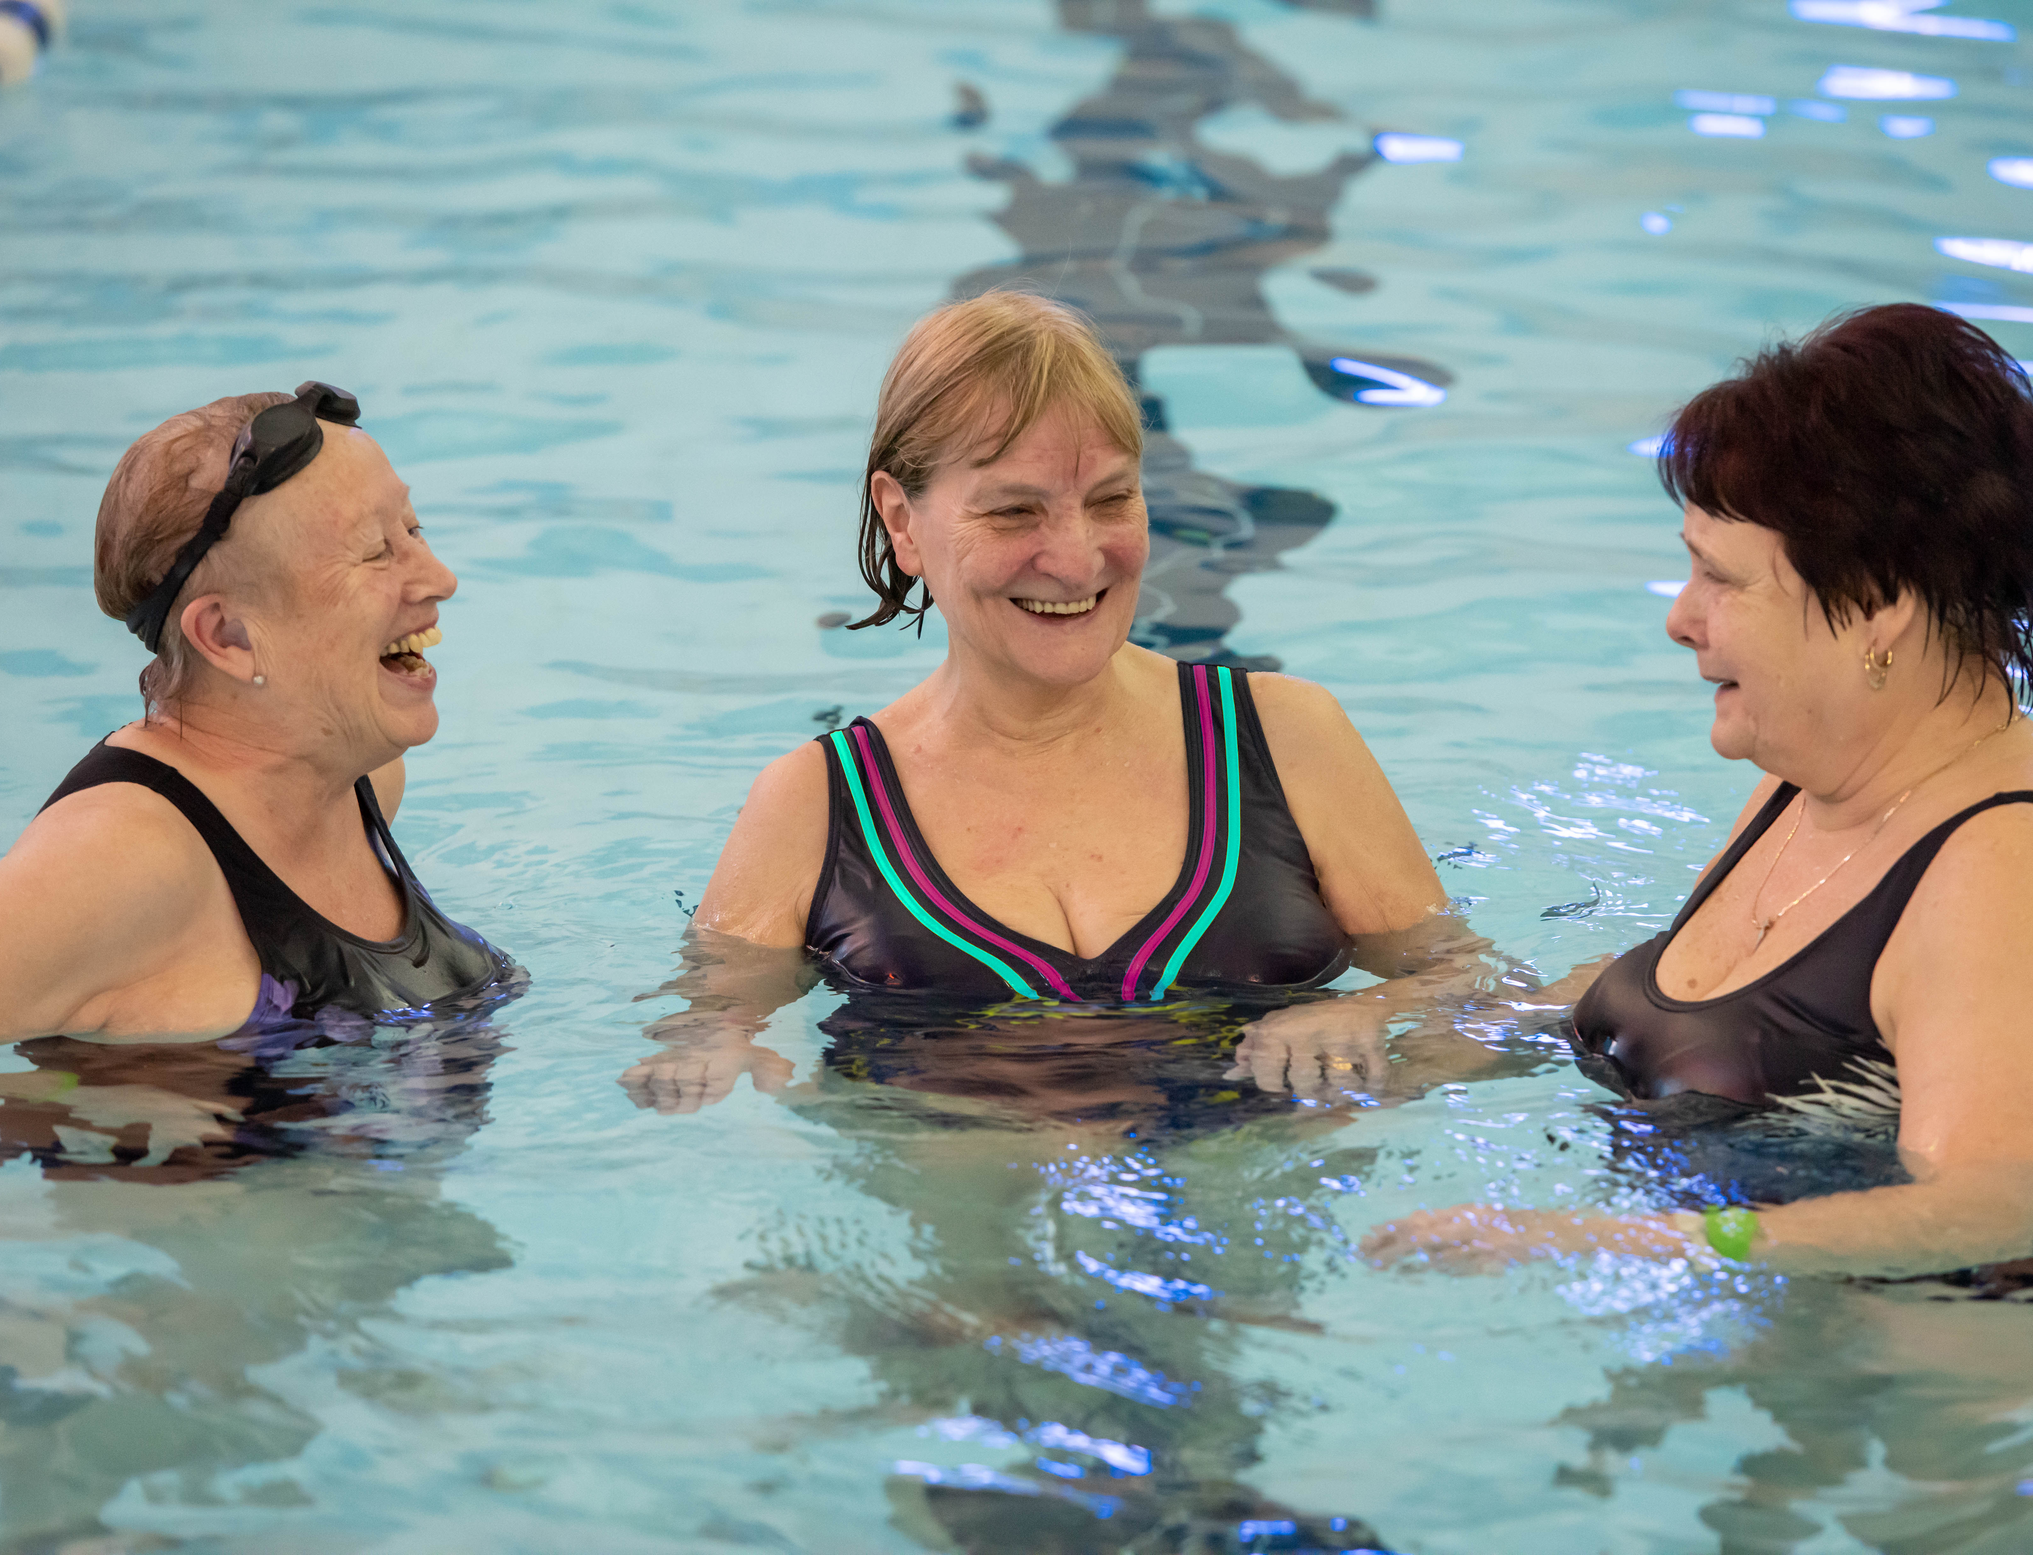
Who is GM Active?
Collaboration of 12 leisure and community organisations
Operating 99 facilities across Greater Manchester
Mission: help people live healthier, happier, more active lives
Unified approach to training, programmes, data, and innovation

Slide 83
Why GM Active Matters to NHS Teams
Delivers clinical‑adjacent, specialist‑led programmes
Supports long‑term condition management
Provides safe, supervised environments for recovery
Extends rehabilitation beyond NHS capacity
Helps reduce readmissions and prevent deterioration

Slide 84
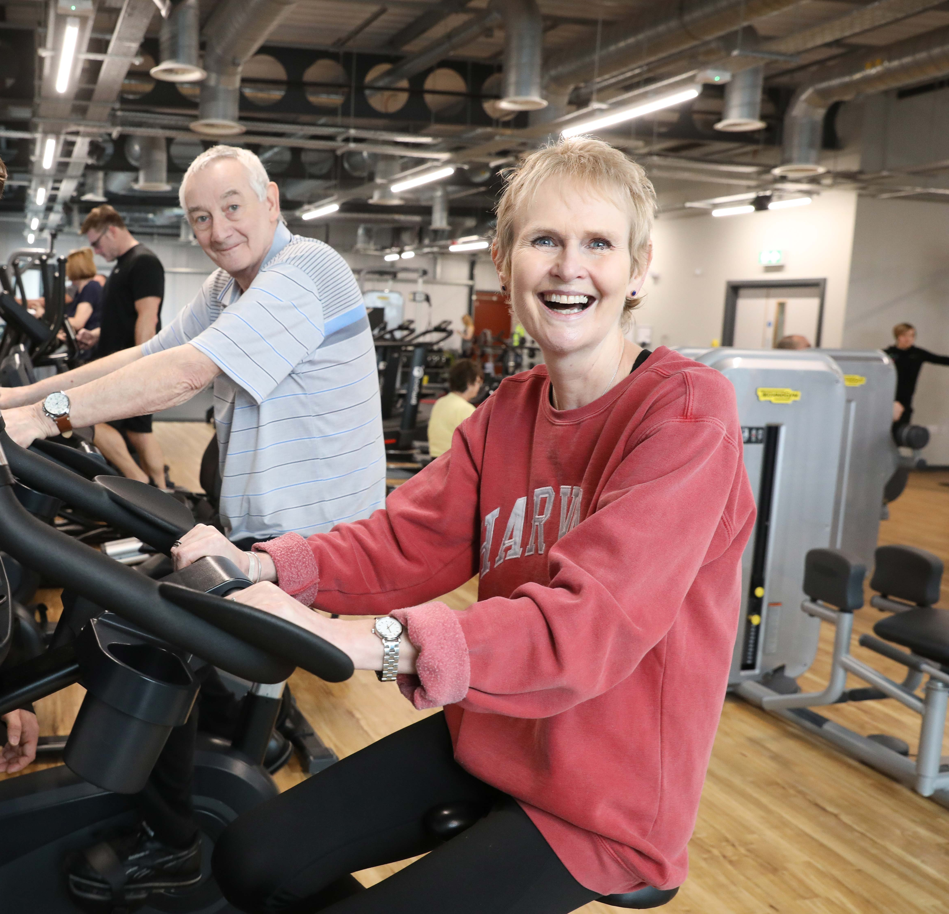
What We Deliver Collectively
Exercise Referral Programmes
Long‑term condition pathways
Neurological condition support
Cardiac rehab and cancer prehab/rehab
Mental health and wellbeing programmes
Falls prevention
Community‑based behaviour change support

Slide 85
Why Physical Activity Matters for Stroke & Neuro Recovery
Improves mobility, balance, and gait
Enhances cardiovascular health
Supports cognitive function
Reduces anxiety, depression, and isolation
Lowers risk of secondary stroke
Builds confidence and independence

Slide 86
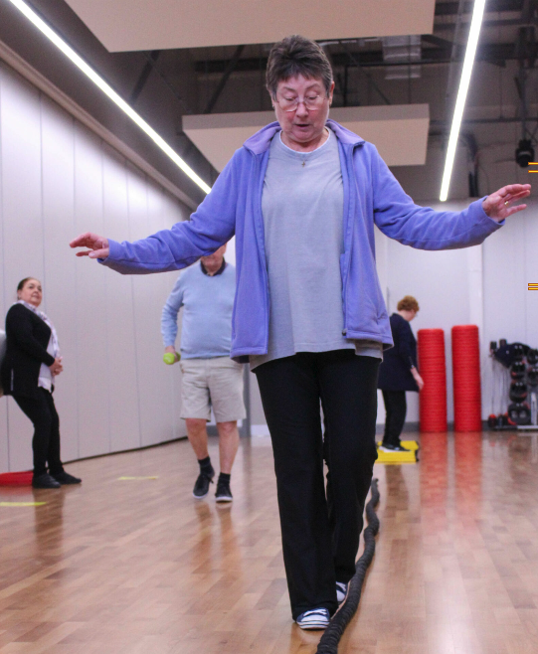
The Exercise Referral Programme
Ranging from 8 – 16-week structured programme
Delivered by qualified exercise referral practitioners
Includes assessment, tailored plans, supervised sessions, and reviews
Designed for people with long‑term conditions, including neurological conditions

Slide 87
Why NHS Should Refer Into GM Active
For clinicians:
Safe, trusted pathway
Extends therapy gains
Supports long‑term self‑management
Reduces pressure on NHS services
For patients:
Local, accessible support
Builds confidence
Reduces isolation
Helps maintain recovery

Slide 88
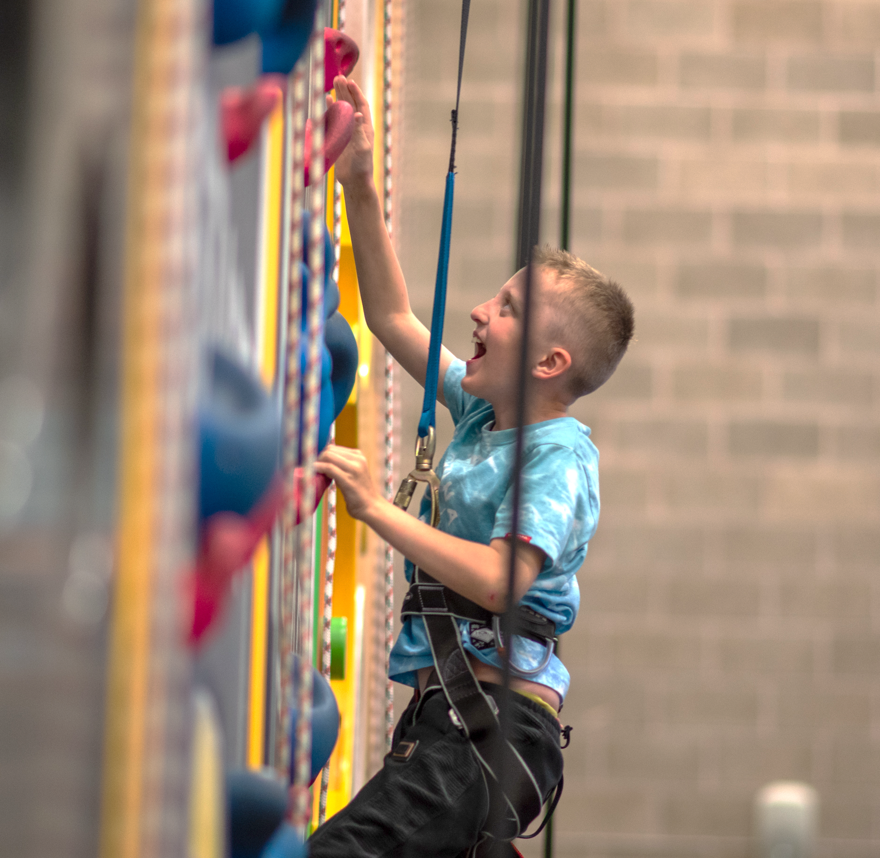
Referral Pathway Overview
Clinician identifies suitable patient
Referral form completed
Sent to local GM Active provider
Patient contacted for assessment
Programme begins

Slide 89
Survey Summary

Slide 90
What the Survey Tells Us Across GM
A consistent offer exists everywhere — but with significant variation.
All GM localities provide some form of stroke/neuro‑appropriate activity
Offers range from basic 1‑1 gym support to full condition‑specific pathways
Stroke/TIA is one of the highest‑volume referral categories across GM
Workforce capability and pricing models vary widely
Waiting times are generally short and positive

Slide 91
Stroke & Neuro Referral Volumes
Stroke is a major driver of demand across GM.
Examples from the survey:
Stockport: 108 stroke/TIA referrals
Wigan: 129
Salford: 123
Tameside: 73
Oldham: 49
Bolton: 30
Neuro referrals as % of all referrals:
Wigan: 15%
Salford: 13%
Stockport: 8%
Oldham: 5%
Trafford: 5%
Bolton: 21%

Slide 92
Workforce Capacity & Training Gaps
The biggest GM‑wide gap is Level 4 neuro‑specific expertise.
Localities reporting need for more L4 neuro staff:
Tameside
Salford
Oldham
Wigan
Current Level 4 capacity (examples):
Wigan: 15
Trafford: 14
Stockport: 8
Oldham: 3
Bolton: 2
Clear message: GM needs a more consistent neuro‑skilled workforce to support stroke pathways.

Slide 93
Cost & Access Variation
Pricing models differ significantly across GM.
Free / low‑cost: Bury Live Well (£0), Stockport (free supervised gym for 12 months)
Mid‑range: Tameside (£14–£22.50), Salford (~£15)
Higher cost: Trafford (£33), Oldham (£60 for 12 weeks), Bolton (£20/month or £100 upfront)
This variation may affect:
Equity of access
Referral confidence
Patient uptake and adherence

Slide 94
Waiting Times Across GM
Most localities offer quick access.
Bury: 1 week
Oldham: 1–2 weeks
Tameside: 2 weeks
Trafford: 15 days
Stockport: 3–4 weeks
Wigan: 4 weeks
Positive message:
GM Active services are generally responsive and ready to receive referrals.

Slide 95
Collaboration with NHS Teams
Joint working is improving — but inconsistent.
Examples of strengthened links:
Trafford: stronger physio network connections
Stockport: partnership with MS Society
Tameside: GLP‑1 workshop for fitness staff
Salford: direct link with Meadowbrook Mental Health
Oldham: new AHP connections
Some localities report no change yet, showing opportunity for further alignment.

Slide 96
What This Means for Our Pathway Work
Clear opportunities for GMNISDN x GM Active collaboration.
Build a more consistent neuro‑skilled workforce
Strengthen referral pathways and shared understanding
Reduce variation in offer and access
Improve equity through clearer pricing models
Use case studies (Alan & Cheryl) to show real‑world impact
Create a seamless transition from clinical care to community support

Slide 97
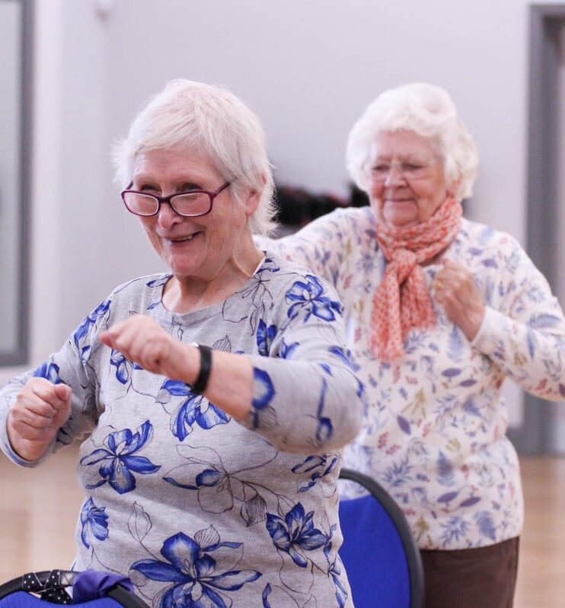
The Opportunity Ahead
Build stronger referral pathways
Share knowledge between NHS & GM Active
Create seamless transitions from clinical care to community support
Improve long‑term outcomes for stroke & neuro patients

Slide 98
Together,
We Can Transform Recovery Across Greater Manchester
Let’s build a stronger, more connected pathway for every patient.

Slide 99







Slide 101
Session 5: Lifelong Support
Local Examples

Slide 102
Implementation of cardio-respiratory group on district stroke rehab ward
Jason Holgate and Kevin Schulz
Physiotherapists Trafford Stroke Rehab Unit

Slide 103
Background
cardiorespiratory training - generally walking (often on a treadmill) or cycling (stationary or recumbent) at sufficient intensity to produce a cardiorespiratory training effect;
resistance or strength training using body weight or equipment to resist muscle contractions with a primary aim of improving muscle strength, power and endurance;
mixed training – a combination of cardiorespiratory and resistance training e.g. circuit training classes.
Programmes of mixed training (medium intensity cardiorespiratory [40%-60% of heart rate reserve] and strength training [50-70% of one-repetition maximum]) such as circuit training classes should also be available at least 3 days per week for 20 weeks
Previous group structure not meeting requirements to support above.

Slide 104
Implementation
Equipment
Establish Inclusion Criteria
HIVE Proforma
Trained Staff
Embedding

Slide 105
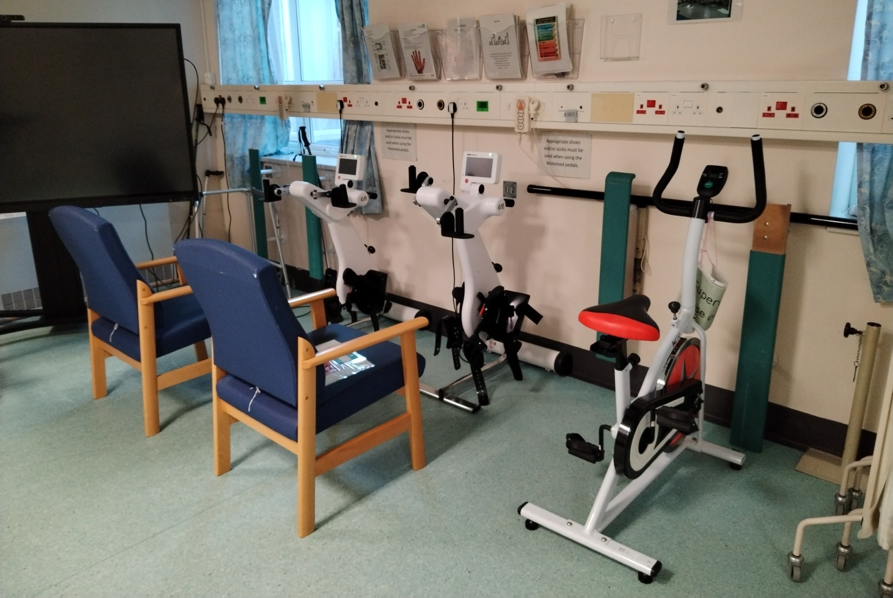
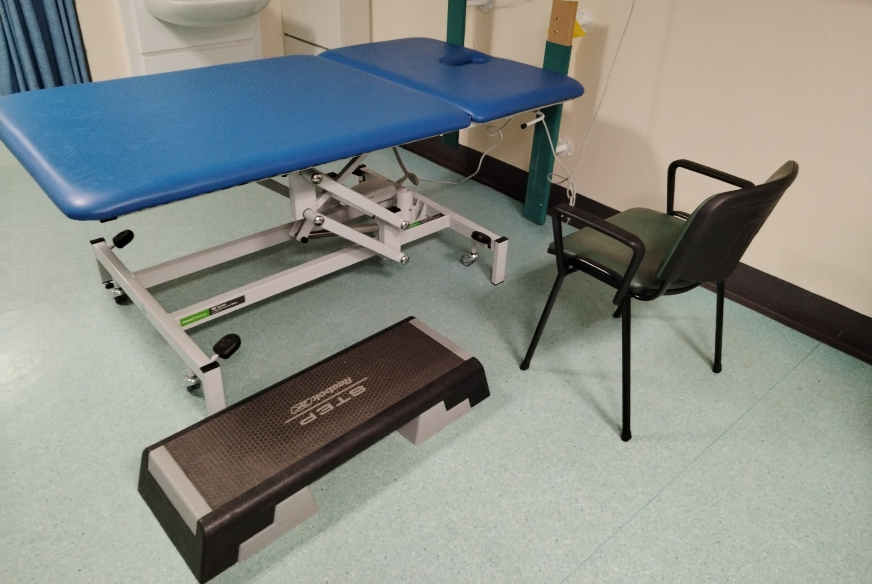
Set-Up

Slide 106
Future considerations/Plans
Formal Audit
Outcome Measures
Exercise Physiology Student

Slide 107
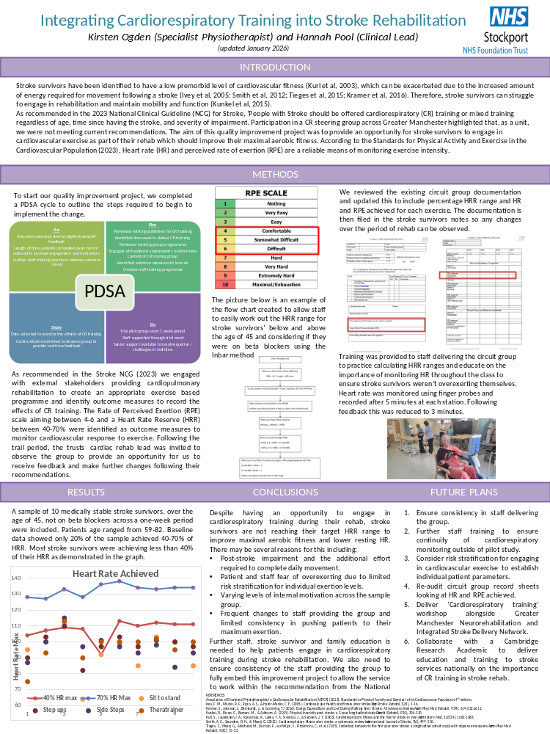

Slide 108
Case Studies
Alan’s Story
Cheryl’s Story

Slide 109
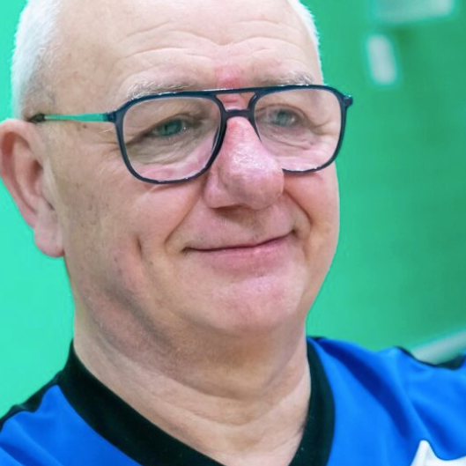
Alan’s Story
Rochdale (Your Trust)
Stroke survivor (April 2019)
Wanted to regain independence
Joined “Moving On After Stroke” at Rochdale Leisure Centre
The Programme
Weekly sessions with Exercise After Stroke‑qualified instructors
Education on nutrition, wellbeing, emotional health, finance, and work
Hybrid delivery (in‑person and online during lockdowns)
Strong peer support

Slide 110
Alan’s Journey
Continued sessions online during lockdown
Built up to 10,000 steps a day
Returned to swimming and gym activity
Completed a 10‑week functional fitness course
Joined a pilot long‑term condition support course

Slide 111
From Participant to Volunteer
Became a volunteer on the Falls prevention programme
Now supports others on their recovery journey
Example of long‑term behaviour change

Slide 112

Impact
Physical:
Improved mobility, balance, and stamina
Emotional:
Increased confidence
Renewed independence
Social:
Reconnected with community
Became a peer role model
Quote
“Alan’s story is an inspiration to anyone who thinks they are being held back by a long-term condition.”
— Elaine Stott, Your Trust

Slide 113
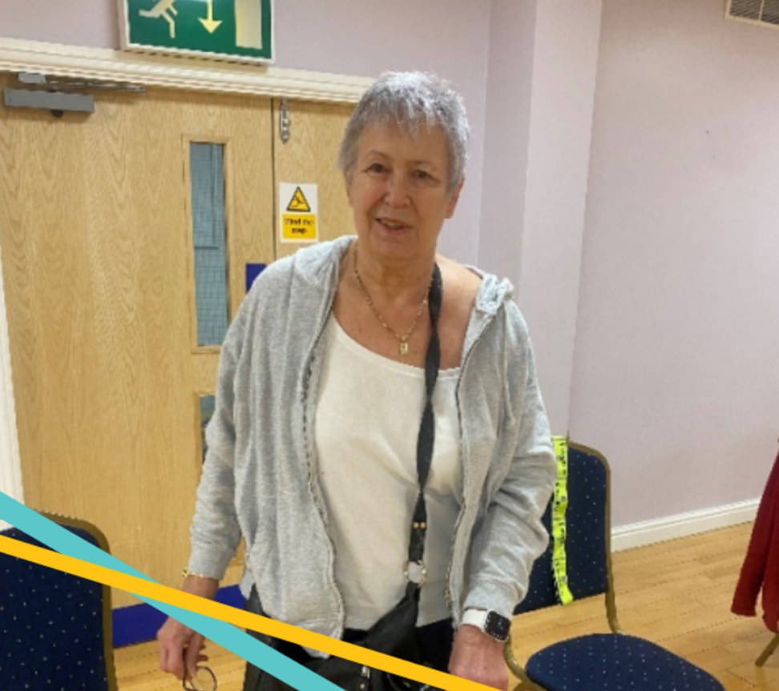
Cheryl’s Story
Bury – Live Well
Stroke in 2022
Referred by stroke team at Fairfield Hospital
Experienced repeated falls
Confidence collapsed
Stopped attending physio due to travel and reliance on her husband
The Challenge
Fear of falling
Anxiety about leaving the house
Loss of independence
Emotional and practical barriers
Significant impact on daily life

Slide 114
The Intervention (Bury Live Well)
Face‑to‑face consultation
Personalised activity plan
Confidence‑building strategies
Emotional support
Gradual reintroduction to movement
Practical mobility support

Slide 115
Cheryl’s Turning Point
Began moving more
Reduced fear of falling
Started leaving the house again
Rebuilt confidence
Regained control over daily life

Slide 116
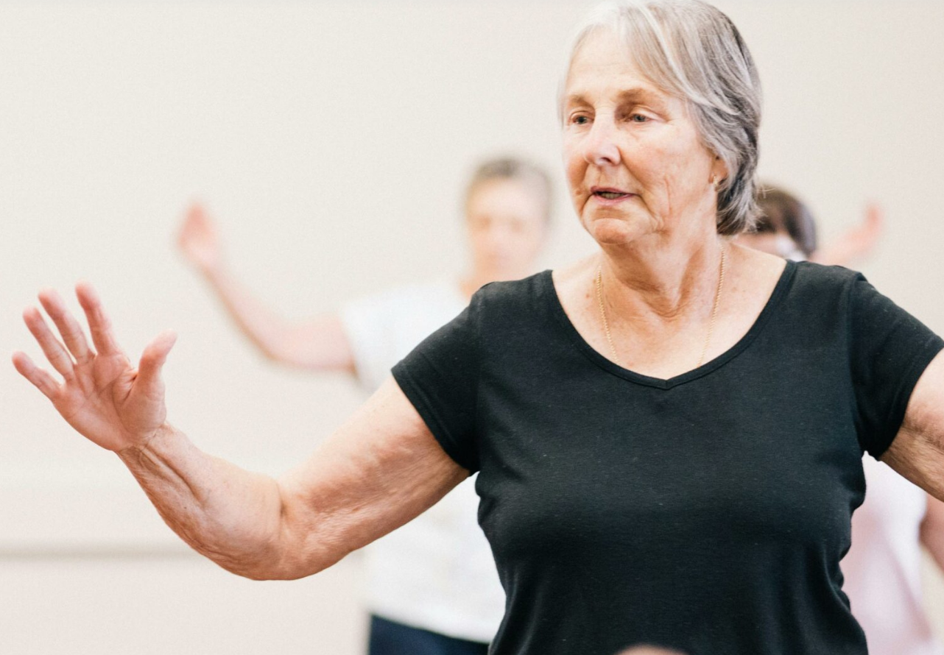
Impact
Physical:
Improved stability
Fewer falls
Emotional:
Confidence restored
Reduced anxiety
Social:
Reconnected with daily routines
Improved quality of life
Quote
“From the first meeting, it was clear how much the stroke had impacted every part of Cheryl’s life. With the right support, she’s regained her confidence and independence.”
— Lizzie Howard, Live Well Officer

Slide 117
What Alan & Cheryl Show Us
Recovery is not linear
Community support fills critical gaps
Personalised activity changes lives
GM Active programmes work across multiple GM localities
NHS referrals unlock these outcomes

Slide 118

Actions & Next Steps
Notes:
Toolkit – what resources do people want
Outcome Measures- Agreement
Timescales – expectation to begin now, retrospective data x 4 weeks. Run Mon-Mon.
Trainer the trainer element
Peer Support group – check in 4 weeks?
Confidence ratings – when to re-assess after period of embedment

