Slide 1


Advanced Sex and Relationship Training Post Stroke and Neurological Conditions
Wednesday 26th March 2024 www.gmnisdn.org.uk
@GMNISDN

Slide 2
Agenda
13.00 – 13.40 | Introductions & Session Recap | Farheen Akhtar & Dr Tamsin Collins
13.40 – 14.30 | Role Play & Reflections | Leona Rose & Jo Stevens
14.30 – 14.45 | Coffee Break
14.45 – 15.15 | Group Work | All
– 15.45 | Complex case discussion on Brain Injury Perspective and Assistive Technology | All
15.45-16.00 | Evaluation & Close | Farheen Akhtar

Slide 3
Presenters
Dr Tamsin Collins
Dr Tamsin Collins is a Consultant in Rehabilitation Medicine with Leeds Community Healthcare NHS Trust.
Dr Leona Rose
Dr Leona Rose is a Clinical Psychologist specialising in neuropsychology. She is currently working with the Stockport Community Neuro Rehab Team.
Joanna Stevens
Jo Stevens is a Specialist Stroke Nurse and ACP as well as joint team lead at Bury Community Stroke and Neurorehab team.

Slide 4
Learning Outcomes
Foster a comprehensive understanding of psychological, cultural, and practical aspects of sex and relationships and within the context of neurological rehabilitation.
01
Equip clinicians with communication and problem-solving skills.
02
Enhance clinician confidence in addressing sensitive topics through interactive methods
03

Slide 5
Sexuality is an integral part of people’s existence and is related to quality of life
The World Health Organisation (WHO) defines sexuality as follows;
A central aspect of being human throughout our life that encompasses sex, gender identities and roles, sexual orientation, eroticism, pleasure, intimacy and reproduction. Sexuality is experienced in thoughts, fantasies, desires, beliefs, attitudes values, behaviours, practices, roles and relationships.

Slide 6
Assessment of sexual dysfunction
Primary sexual dysfunction
  Neurological changes directly impairing sexual response/ feelings
Secondary sexual dysfunction
  Disease related changes which indirectly affect sexual response
Tertiary sexual dysfunction
  Psychological and cultural issues which can interfere with sexual feelings and response
                Foley and Werner 2012

Slide 7
Primary Sexual Dysfunction
Reduced/ absent libido
  Brain lesions
  Endocrine
Hypersexuality
Impaired/ altered genital sensation
Lack of/ decreased intensity/ frequency of orgasm
Erectile dysfunction
Ejaculatory dysfunction
Reduced vaginal lubrication

Slide 8
Secondary
Sexual Dysfunction
• Loss of movement
• Loss of sensation
• Spasticity
• Pain
Fatigue
• Bowel or bladder dysfunction
• Dyspraxia
Dizziness
Oral dyspraxia
Visual field deficit

Slide 9
Tertiary Sexual Dysfunction
Cultural values re sex and disability
Lack of spontaneity
Anxiety or depression
Low self esteem/ body image
Social opportunities
Role models?
Lack of privacy

Slide 10
Intimate Relationships
McCarthy et al (2020) identified seven themes of challenge.
Coping with the direct effects of the injury (communication, physical, behaviour and cognitive difficulties).
Incongruence in perceptions between survivors and caregivers (ability, rehabilitation efficacy, future expectations)
Strained communication (practical and emotional needs)
Managing worries (Financial and future health habits)
Adjusting to changing roles (survivor/caregivers, responsibilities, inability to resume past activities together, change in intimacy)
Amplification of existing relationship difficulties (behaviours, personaility)
Lack of support from other family member or friends (lack of understanding, isolation)

Slide 11
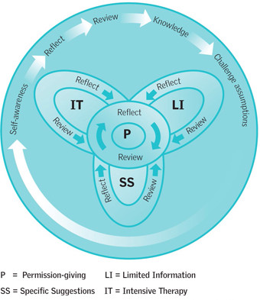
Ex- PLISSIT Model
P- permission
LI- Limited information
SS – specific suggestions
IT – Intensive Therapy
        (Annon 1976)
        (Davis and Taylor 2006)

Slide 12
How do we talk about intimate relationships?
What can we learn from IPM approach?
  Institute of psychosexual medicine, founded 1974 by psychoanalyst Tom Main
  Learn by case presentation to a seminar group with trained leader
  Uses brief interpretive therapy
  Skills that clinicians can use during any short or long consultation in lots of settings
  Institute of psychosexual medicine www.ipm.org.uk

Slide 13
What can we do in our consultations
Prepare for the consultation- go into it with interest and curiosity
Make space for what is not said
Stay with the feelings/ emotions being expressed
Be OK with not knowing
Reflexivity. Be aware of your own and others’ feelings. Can you use them to help the patient?
What sort of clinician are you being?
Reflect afterwards on how it went

Slide 14
Role play- Acute setting
Can you reflect on how you would adjust your tone or wording based on patient responses.
How did that feel for you if you were the patient?
Would you have approached anything differently?
What else could the clinician have asked?

Slide 15
Role play – Community setting
Can you reflect on:
How did the clinician create a safe environment for the patient?
How did the patient engage with the conversation?
How did the clinician balance offering support with giving space for the patient’s feelings?

Slide 16
Group Scenario 1 – Acute
How to open the conversation sensitively.
How to explore the patient’s feelings about changes in her body.
How to address relationship dynamics without making assumptions.
What support services (e.g., mental health, OT, couples therapy) could be useful.

Slide 17
Group Scenario 2- Community
How to create a safe and inclusive space for the patient.
How to address both physical and emotional aspects of sexual health.
How to encourage open communication between the patient and his partner.
Are there LGBTQ+ inclusive resources available for further support.

Slide 18
Impulse Control Disorders
Increase in sexual interest, arousal and behavior that is out of keeping with premorbid behavior
Increased desire and demands for sex
Transvestism, paraphilias, change in sexual orientation or gender identity
Prevalence in treated Parkinson’s Disease – up to 4%
Prevalence in Dopamine Agonist users – up to 7.2%
Commoner in Men and earlier onset of disease ( Parkinson’s)
Coding, Shaw, David 2016

Slide 19
Increased frequency of masturbation
Partner being harassed for sex
New interest in sex toys
Telephone chatlines and internet sex sites
Voyeurism
Indecent exposure
Use of sex workers
Multiple sexual relationships
Assault
How can it manifest?

Slide 20
Challenges with management
There is not always a clear relationship between timing of a dose increase
01
Stopping or reducing dopaminergic medications may reduce propensity to act but may not lessen intensity of preoccupations
02
These disorders can also occur in women
03
Can occur in people who aren’t taking Dopamine agonists
04

Slide 21
Physical, cognitive, emotional and behavioural effects of brain injury
Hyposexuality more common than hypersexuality
Brain injury survivor may lose interest in their sexual partner
Partner may no longer be sexually attracted to brain injury survivor- guilt and confusion
Personality change- not the same person
Brain Injury

Slide 22
Disinhibition:
  Disinhibited sexual behaviour can include: Sexual conversation or content comments and jokes of a personal or sexual nature inappropriate touching or grabbing.
  Explicit sexual behaviour:
  • sexual propositions
  • exposure of genitals or nudity in public
  • masturbation in a public place
  • unwanted touching
  • sexual assault
Hyper Sexuality Following Brain Injury

Slide 23
How to support the patient/partner and how to manage risk issues
Talk to the person about their behaviour and what you or others expect.
01
Let them know if behaviour is not appropriate – if they don’t know, they can’t change it.
02
Let them know how the behaviour makes you feel e.g. “I feel uncomfortable when…”
03
Let other people know what strategies to use.
04

Slide 24
What to do about risk
Check with the patient and their partner (if there is one) if they have any worries about sexualised behaviour.
Share your observed concerns with the patient/partner (they might not always have insight into the risk).
Seek consent to refer to specialist input (neuropsychology, psychosexual counselling). If this is not available in your team, you may be able to access tertiary services.
Share risk concerns in the usual way in your service, e.g. discuss with leads, share with safe guarding for additional advice and support.
Try not to be worried about raising these concerns, adult social care will have experience in this area.

Slide 25
Impact on partners following brain injury
Sexual activities are often undertaken with a partner, and the impact of the brain injury is often felt by them as well.
The survivors effects may cause the partner to no longer feel sexually attracted to the them, this can lead to feeling of guilt and shame.
Conversely the survivor may have lost interest in sex and this is challenging for their intimate partner.
The impact of the caring role for the partner and the survivor can also understandably have an impact and can lead to changes in how they view each other.
It is important to consider the impact on partners as well and to highlight to them that support is also available to them.

Slide 26
Assistive Technology
Jo Stevens

Slide 27
MDT approach
Bed mobility
Slide sheets
Cushions
Handling belts
Positioning suggestions
Oral dyspraxia training
Catheters and skincare
Pacing and planning
Seated positions for vestibular problems

Slide 28
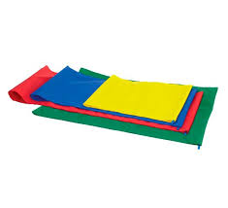
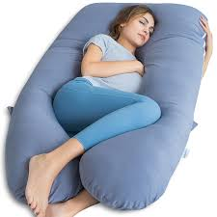
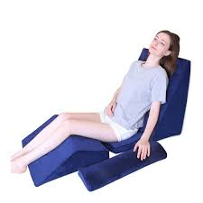
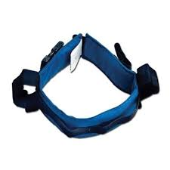
What can we get that can be put to different use?

Slide 29
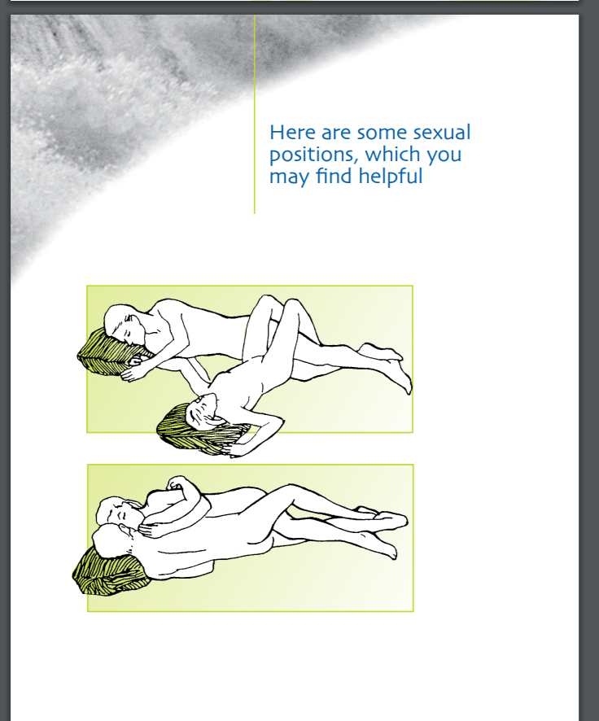
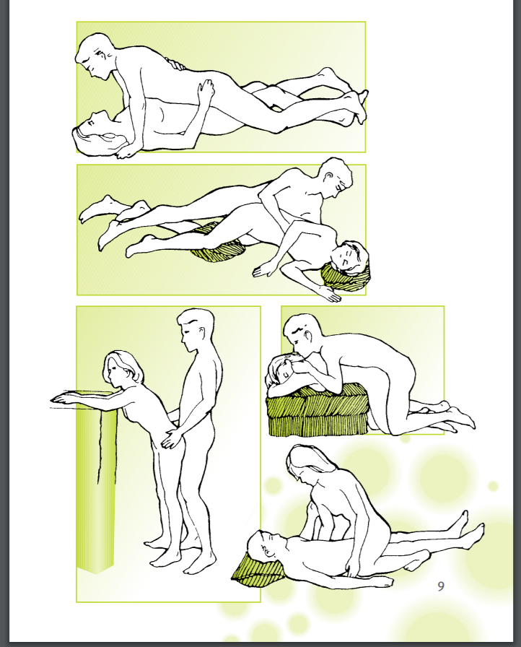

Slide 30
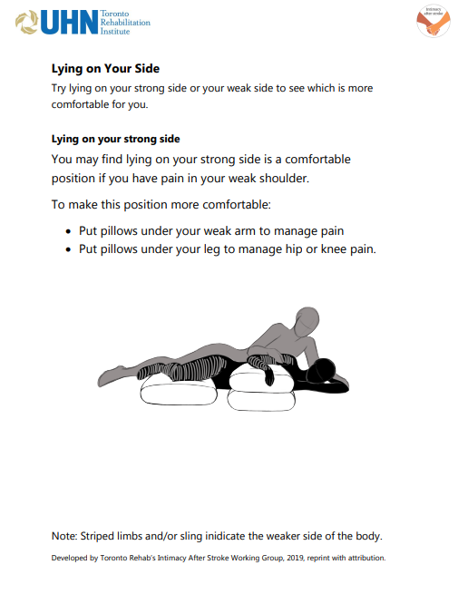
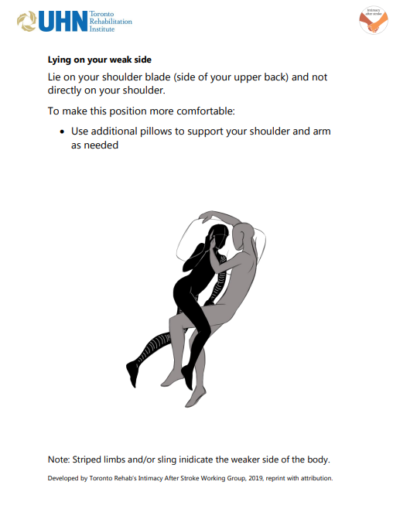
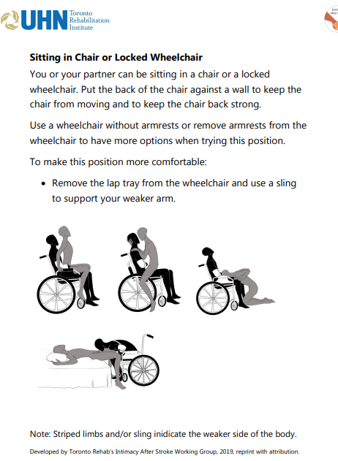
Comfortable Sex Positions For Patients Who Have Had a Stroke

Slide 31
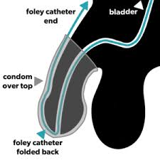

Hygiene, incontinence and sex

Slide 32
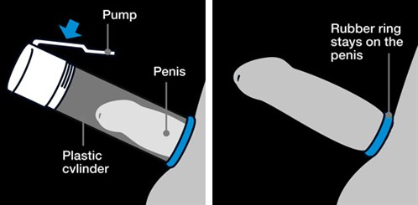
Mechanical devices
Vibrators for dyspraxia
Lubricating gels
Seated positions for vestibular problems
Vacuum constriction devices (VCDs)

Slide 33
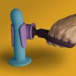
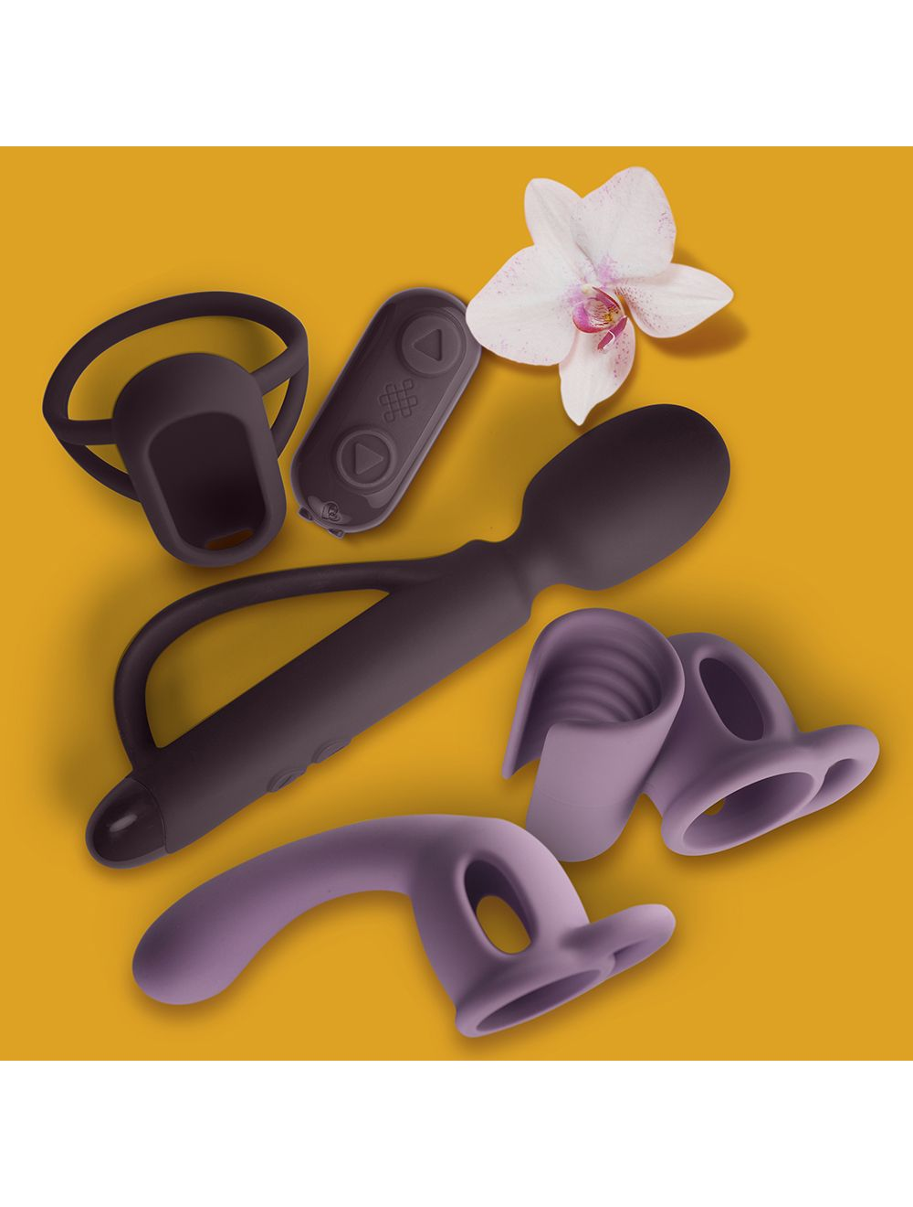
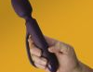
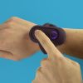
Other adjuncts that may help
www.spokz.co.uk
http://www.dhrn.ca/files/sexualhealthmanual_lowres_2010_0208.pdf

Slide 34
Resources
The resources below have more information on sex positions, products and devices that may help sexual function:
Book: The Ultimate Guide to Sex and Disability: https://www.corysilverberg.com/sex-and-disability
Pleasure ABLE: Sexual Device Manual for Persons with Disabilities http://www.dhrn.ca/files/sexualhealthmanual_lowres_2010 _0208.pdf
Sexual Aids: www.mypleasure.com/education/disability/index.asp

Slide 35
Websites to help
http://differentstrokes.co.uk/stroke-information/downloads/
https://www.stroke.org.uk/sites/default/files/sex_after_stroke.pdf
https://www.chss.org.uk/documents/2014/05/sex-after-stroke-illness-pdf.pdf
https://www.headway.org.uk/media/4995/sex-and-sexuality-after-brain-injury-e-booklet.pdf
https://www.chss.org.uk/documents/2013/08/ss6_sex_after_stroke_website-pdf.pdf

Slide 36

Tips for online dating
Danielle Sheypuk

Slide 37
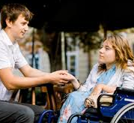
Tips for online dating
Most popular way to meet people
Harder with disability but need to recognise and accept it and get out there
Swipe 5 x yes each day
Dating profile
What do you want in a partner
Deal breakers?
Favours being upfront about disability but don’t need to reveal info that makes you uncomfortable
Include a whole body photo

Slide 38
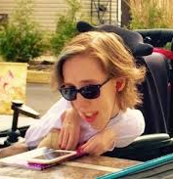
Sites geared towards disability – not enough profiles and ? devotees
Free sites more likely to include scammers or fake profiles ( cat fish)
Most popular sites are
  Hinge ( unpaid)
  Match.com ( paid)
  Bumble ( unpaid)
  eHarmony ( paid)
  OK Cupid ( unpaid) Tinder (unpaid),Plenty of fish ( unpaid)

Slide 39
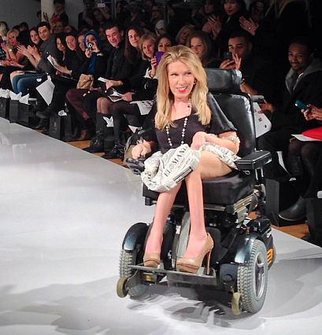
Message and get to know person then meet virtually
If don’t want to meet virtually 1st this is a yellow flag
Block anyone who is offensive
TED talks danielle sheypuk - Google Search

Slide 40
Resources
https://gmnisdn.org.uk/professionals/sex-and-relationships/

Slide 41
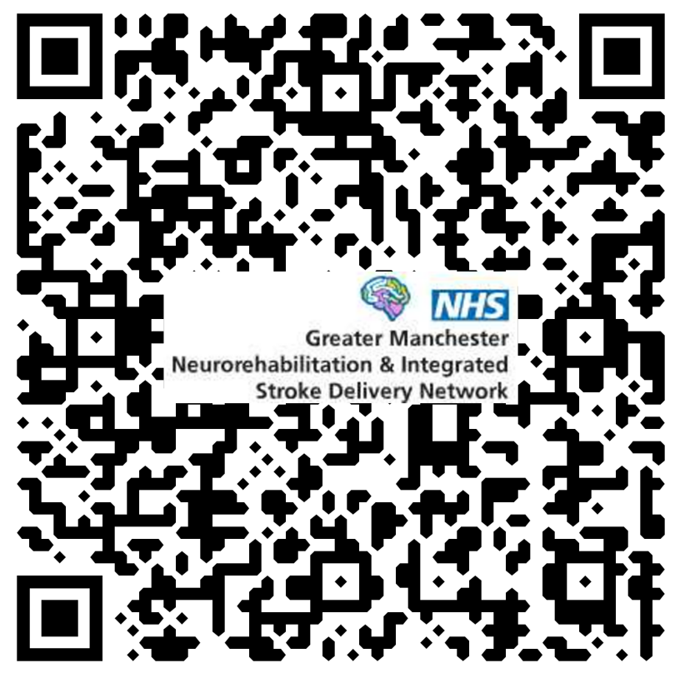
Thank You Evaluation

