Slide 1


Patient and Public Involvement
How to involve the VOICE of people affected by neurological conditions in our work

Slide 2

What we’ll be covering
Welcome
Barriers to involvement
‘Thinking involvement’
‘Doing involvement’
Toolkit for involvement
When you could use involvement
Take-aways
Notes:
Welcome to this bite sized learning session on Involvement. The aim of this whistle stop session is to guide you through the process of involving people with lived experience of neuro conditions n your work.
In this session, we’ll be looking at what involvement is and isn’t; why its important to involve people with neuro conditions in our work; when to involve them, and how to .

Slide 3
What is Involvement?
It’s not the same as engagement
It is including people in your design and decision process
It is asking for their opinion and view-point
It can be changing the course of your plans
It often means being prepared to give up some control
Notes:
So what is involvement? It’s possibly easier to explain what it’s not.
Although we often use the terms involvement and engagement interchangeably, there is a difference in the two.
The main difference is that in one your retain control and in the other you give up some control – and the balance of power shifts depending on how you involve people.
In practice what does this mean? Well a good example is in this the delivery of this session. At it is I’m currently using engagement as a means to share information. I’ve pre designed these slides, and I’m delivering this session to you.
If I was involving you, I’d be including you in the design and decision making process, how many slides, what they should look like, and seeking your point of view and feedback at every stage. I might even have asked you whether a session on Involvement would be useful! (And I would have needed to be prepared for the answer to be a ‘possibly’ or even a no – that’s involvement).
So when we talk about Involving people with neuro conditions in our work, that’s really all we’re talking about.
It’s including them as participants in the design and decision process, as co-production team mates, not as passive recipients at the point of delivery (or engagement).
And I thinks also fair to say that a lot of what I’m talking about here can be applied to involving HCP, too, if that’s your area of work.

Slide 4
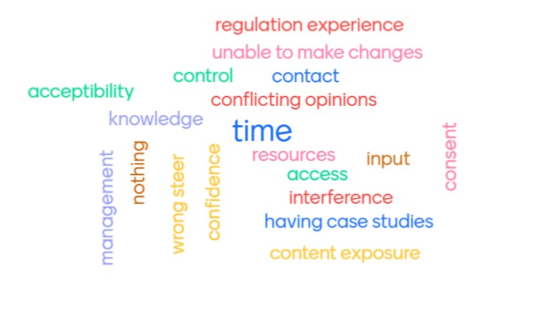
What gets in the way?
Notes:
So before we go any further and start to explore how to do involvement, and ask you all to participate in exploring what the barriers to Involvement are.

Slide 5

Thinking
Involvement – the ‘Why?’
Notes:
It’s fair to say that for most people, involving people with lived experience can be daunting. It can take more time, and it can make your project a lot more complicated.

Slide 6
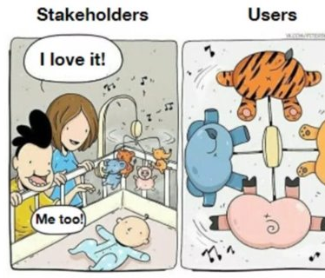
Involvement is a different perspective we might not have considered ourselves
Notes:
So (concerns taken into account) what’s the value of Involvement?
Well from a stakeholder (or in this case, our) perspective it’s easy to steam ahead, to think we just do things the way we always have.
If we know our subject well – as we do at the network – then is there really anything to learn?
But taking a step back and allowing ourselves to stand in the shoes of the users – we always see there’s something new to discover; a different viewpoint that we’re not seeing without that lived experience input.
Involvement helps us see things from the user’s viewpoint; take people with us on a journey, encourages them to try a new service or a product, and helps to build brand loyalty.
It’s also helps us to ensure that our customers feel valued enough to stick with us when something that already exists, is changing.
So to answer the question what’s the value of involvement – you could answer it with another question. If we could we provide something better, or more meaningful through involvement – then why NOT involve people with neuro conditions?

Slide 7
And if that’s not enough…
People with neurological conditions are experts by (their lived) experience
Doing ‘with’ not ‘for’
See it as an opportunity – part of the solution not a problem
People value being involved
“Pleased that I was listened to, my point was actually taken on board, and it was not a tokenistic exercise”
Notes:
And why it matters…
We all know that people with neuro conditions experts of their own condition. They live with it day in and day out, and are best placed to tell us whether what you’re planning to create, deliver, build, develop or ask, will resonate with people with neuro condtions..
They’ll tell you what environmental or external factors could make your campaign land badly. Or why something that’s been added to a webpage doesn’t read well, a particular layout is confusing or needs less text and more images.
Or why the pages of an information booklet are hard to turn, for someone experiencing spasticity.
In the way that no two people with neuro conditions experience them in the same way. No two people with neuro conditions ill give you the same opinion. So prepared to cast your net wide and ask many. The more you can ask the better.

Slide 8
Doing Involvement – the ‘How?’
Notes:
So we’ve looked at why it’s important to involve people and now the how. In this section I want to look at some of the tools of Involvement that you can use and where they might be useful in your roles.

Slide 9
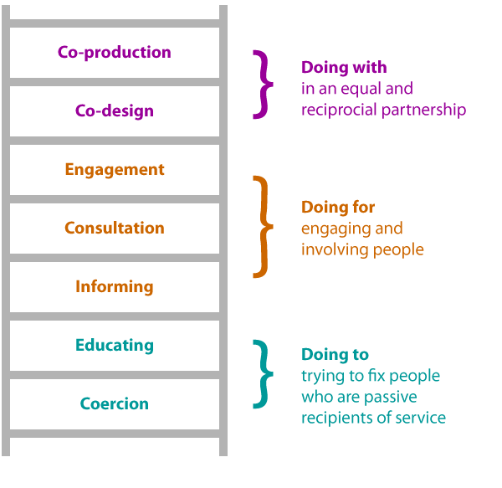
The Involvement Ladder
Notes:
BH
So where do you start?
You’ve got an idea for a project or something you want to change. So you could start by thinking about where in the project it would be good to involve them
The Ladder of Involvement, gives a good visual representation of the different levels of involvement you can aim for, within any project.
At the bottom of the ladder we have the ‘doing to’ level, we can use this when we’re trying to improve or adapt something that already exists.
An good example of this might be asking people to read or review something that’s already 70% or more, complete. Or comment on something they are familiar with.
In this situation our lived experience users are involved, but it’s more likely that they’re involved at the end of development; just before something has been signed off.
Or they might be involved by being asked their opinion, but that involvement isn’t necessarily going to change the course of action, or it might not be critical to the project outcome. But it’s still Involvement.
Then as we move up the ladder towards ‘doing for’ you can see that the power shifts a bit – and we’re involving at a more engaged and consultative level. In practice this might mean that we’re bringing people with MS into the project when it’s 50% complete, so they’ve got a greater say in the project, and depending on what they tell us, we’re likely to change course to incorporate their ideas or suggestions.
And the further up the ladder we go, the power shifts even further still. At the top of the ladder, we’re doing with and working in co-production and co-design in an equal partnership. At this level, the power sharing is equal – in fact it could even be unequal in favour of the service users, and at this stage only 10% of the project has been agreed before you involve pwMS - and that’s usually budget and resource.
There's no right or wrong for where you should be on the ladder. Each project is different. Sometimes we need to consider whether full co-production, at the top of the ladder, is feasible and appropriate – there will be occasions when it is just not possible, for time reasons or if something has started already, or if there are confidentiality or safeguarding issues that need to be considered.
But with most best practice Involvement, it’s good to aim for the middle or above.
Next slide
Useful to check in from time to time:
where you think you/your project is on the ladder?
Where should it be? Where is it appropriate for it to be?
Is there any way you could move up to the next rung?
What could you do to get there?

Slide 10

Tools of Involvement – Pros & Cons
Surveys – easy; familiar; quick
BUT not available to all; accessibility; selection bias
Interviews – build trust; depth of topic
BUT time consuming; hard to stay on topic
Focus Groups – time efficient once set up
BUT not everyone is comfortable speaking in front of others or “on the hoof”
Stakeholder Groups – better for lengthy projects
BUT time consuming and intensive stewarding
On-line group/forum – quick; easy to set up
BUT safeguarding/monitoring issues and risk of ‘copycat’ opinions
Notes:
I’m sure nothing new in these tools. Many of you may have used or already be using these tools in your roles in other ways. But as part of this section i’ll just run through their uses in Involvement.

Slide 11
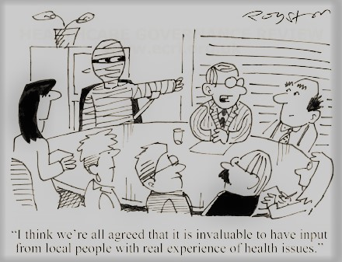
Ethics of Involvement
Consent to use data
Safeguarding & support
Compliant with GDPR & Data Protection Act 2018
Morals of Involvement
Who is involved
Where they’ll make a difference
Why the project is happening
What they’ll do
How long/duration
When they’ll find out results
Notes:
Another consideration is whether you’re involving people in a way that is ethically and morally appropriate.
In practice this means that you consider the full lifecycle of the project, with regard to those people you’ll be involving, so that they are meaningfully involved.
So morally - at the outset, they need to understand how long the project will run, what it’s setting out to achieve, where their involvement will be needed and when they’ll find out how their input made a difference. If a project doesn’t have all of this – the people you involve won’t have closure, and won’t see how their time and input made a difference – and they won’t have had a positive experience. So it’s really important to build feedback into the cycle. You can even ask them where and how they are fed back to if you’re not sure where it should be.
And ethically – you should think about how you are collecting and storing any insights you’ve gathered, whether you plan to anonymise the data, how long you keep it and who you share it with. If you’re not sure it’s worth checking on this, to ensure that you’re doing everything in a way that is compliant with the GDPR and Data Protection Act 2018. You could also consider whether you want to collect EDI data. Checking in with data controller on this, to ensure you’re following the most up to date protocols.
Because Involvement uses research methods, you should also gain consent from those people you’re involving, at the outset, with regards to things like the recording of focus groups and interviews, as well as their right to withdraw from the process at any point.
And one final thing, if a project hasn’t reached it’s conclusion, or has had to be shelved, or has changed course due to other factors out of your control it’s so important to keep people informed.
Having people involved in something and then not keeping that conversation going or making them feel excluded is bad for everyone.

Slide 12

Involvement Scenarios
Scenario 1: You are involved in a project that is looking at making a changes to the hours that a community neuro team operates. What involvement tools could you use to ensure that any changes are as positive to people affected by a neurological condition as possible?
Scenario 2: You have been asked to get feedback from people affected by a neurological condition about the way that they get information when discharged from hospital from their specialist care team. How could you go about ensuring you hear from as many people as possible?

Slide 13
We are thinking about making some changes to some areas of a programme – would you like to work with us to design them?”
We are planning to make some changes to the programme. What would you like to see? What do you think needs to change?”
We are planning to make some changes to the programme – what do you think about these suggested changes?”
We are going to make some changes to the programme, this is what it is going to look like. Do you have any feedback?”
Changes are made to a structured project/programme delivery, and the new version starts.
Notes:
BH
Here’s a more comprehenasive version of the ladder. Useful to help you check what is appropriate and where.
Useful to check in from time to time:
where you think you/your project is on the ladder?
Where should it be? Where is it appropriate for it to be?
Is there any way you could move up to the next rung?
What could you do to get you there?
Next slide
Examples of the ladder
Going back to our ladder of involvement. Talk through each stage, and give an example:
Coercion / Educating: Doing to: example = made some changes to the SE service delivery and the new version starts.
Maybe slight difference between them in that educating would perhaps talk them through it first, explain where things have changed. But no chance to contribute or change.
Informing – might look like this: “We are going to make some changes to the programme, this is what it is going to look like. Do you have any feedback?”
Might introduce some level of insight gathering after they’ve used the service and use it to improve
Consultation – “We are planning to make some changes to the programme – what do you think about these suggested changes?”
Engagement – starting to involve them. “We are planning to make some changes to the programme. What would you like to see? What do you think needs to change?” See the power shifting.
Co-design – “We are thinking about making some changes to the programme – would you like to help us design them?” Involvement on a steering group/planning group. Partnership working. Power sharing
Co-production – As above, but they will be involved in producing the service as well as design, which might even involve co-delivery.

Slide 14

Things to consider
For each scenario, think about:
  What would good involvement look like in each scenario?
  How would you go about it?
  What level of involvement on the ladder is appropriate for this?
  What considerations would you make?
  What challenges might you face?
Notes:
So taking the first one – volunteering – you could send out a survey or an open forum question about this – on fb. Sometimes ask the question in reverse helps – ‘what puts you off volunteering your time?’ People are always quicker and keenser to tell you what they don’t like about something than what they do like about it.
And the second one – USP – explore what people know about MS Nurses and the education programmes we deliver – hold focus groups or a task and finish project to really understand how people would want to hear about that. It might be that message could be shared more widely through fundraising – or it might be in another way.
You can be guided by looking at these points – thinking about the challenges you might face, but also the opportunities that each approach would present.

Slide 15
The Involvement Ladder - where is your project and could it be higher?
Notes:
Whatever method you choose, it’s useful to check in from time to time:
where you think you/your project is on the ladder?
Where should it be?
Is there any way you could move up to the next rung?
What could you do to get there?

Slide 16
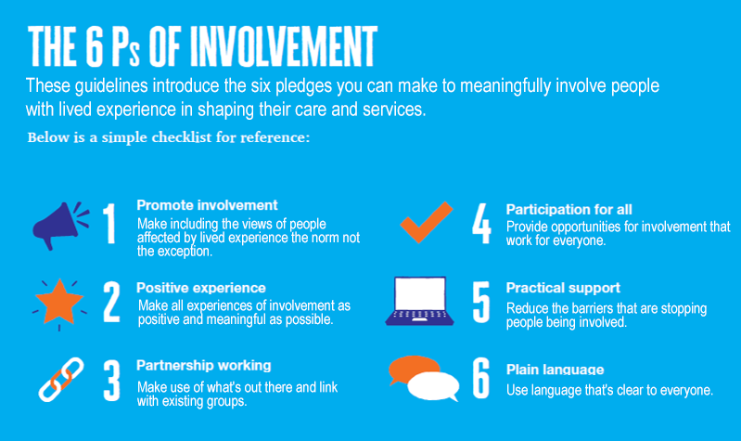
Notes:
And rounding up - whenever you’re considering Involving people – there are 6 pledges you can remember, to help make sure you have it all covered.
I actually start these in reverse, with number 6 – use of language is really important. Keep things as simple as you can.
And then removing barriers – so make sure people non-digital can get involved and your advert or call out is accessible.
Try to make sure that it fits all – accommodate people at different working times/consider the needs of the neuro community.
If you can save time and legwork by working with partners – this could be external partners such as Healthwatch or VSCE. Or long term health condition.
Give them a positive experience.
And think involving people the norm not the exception.

Slide 17
Can we involve patients/carers in this workstream? If not Why?
What level of involvement will we need?
When is it appropriate to engage them?
Who do we need to engage in this work?
Where will we find them?
How many methods of involvement from the toolkit will we use?

Slide 18

Top tips
Involve at earliest stage – needs to be embedded and co-designed
Doesn’t have to be perfect - and probably never will be
Be brave
Choose the right level for your project
Choose the right methodology
Always consider about digital exclusion
Notes:
At earliest stage, the earlier the better.
Don’t get hung up on things being perfect – if you think it’s too soon to involve someone with a neuro condtion, it isn’t.

Slide 19
And…
Think about diversity and representation
One size doesn’t fit all – know your audience
Ask for feedback
  Meaningful involvement can be incredibly rewarding….on both sides
Be ready to give up some control!

